Slide 1
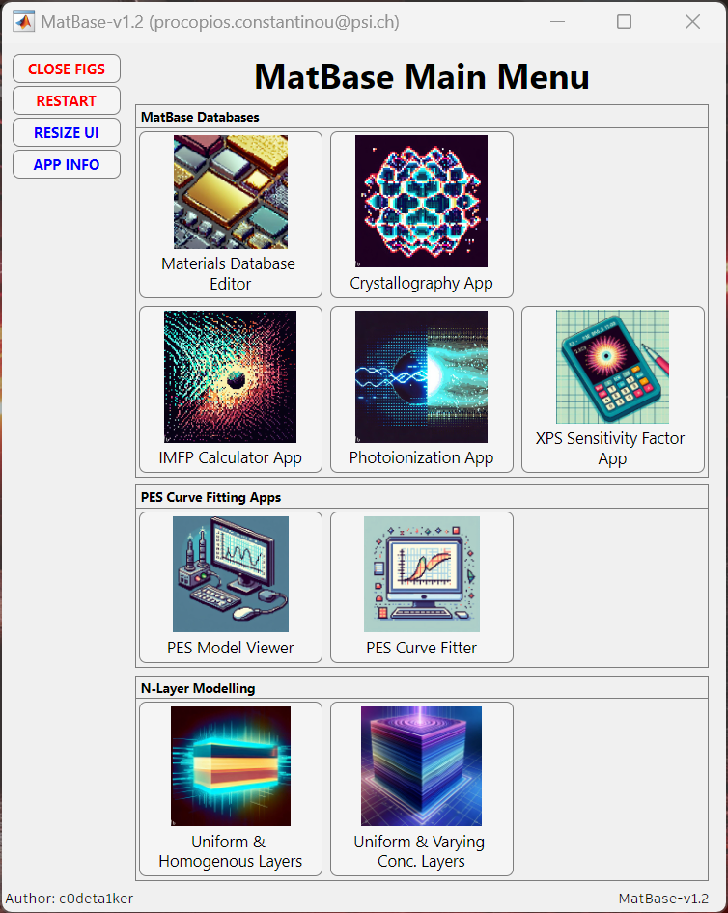
MatBase Main Menu

Slide 2
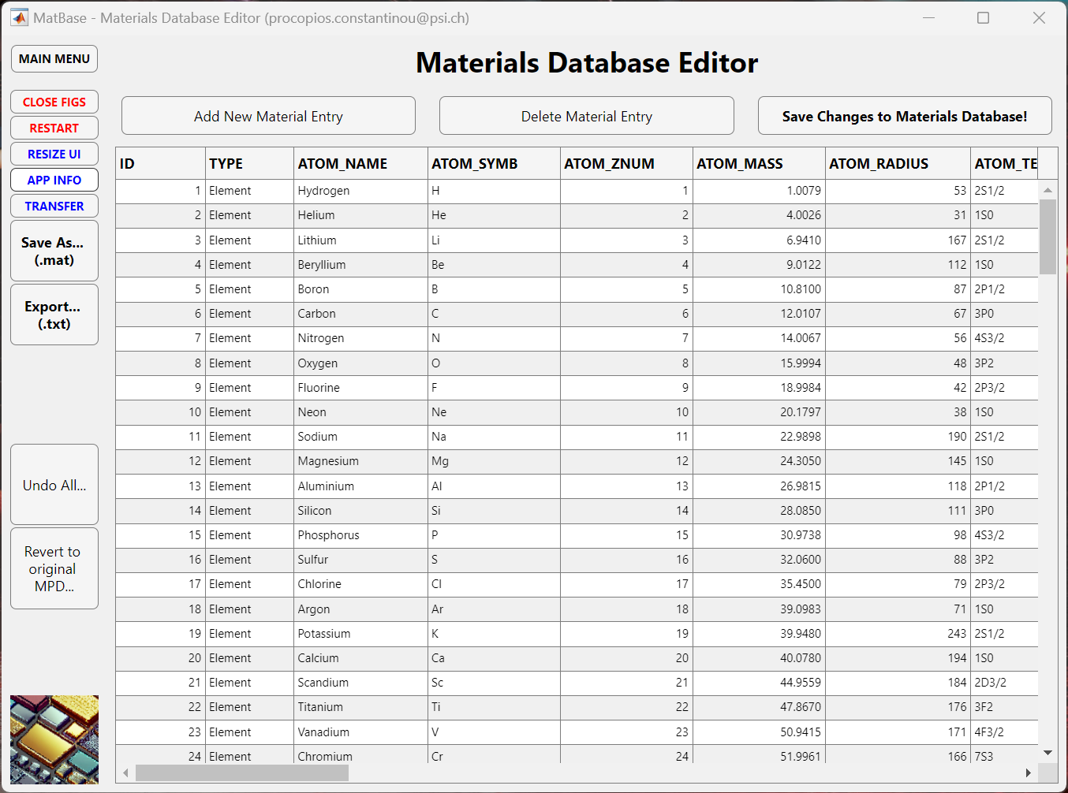
Materials Database Editor
Currently 168 material entries with 42 properties each.
View all material entries and manually enter new data.
Elements, Oxides, Binary Semiconductors & Ionic Salts Data. Database saved in ‘MPD_PCC.mat’ MATLAB file.
Use ‘get_mpd_props()’ to extract material properties.

Slide 3
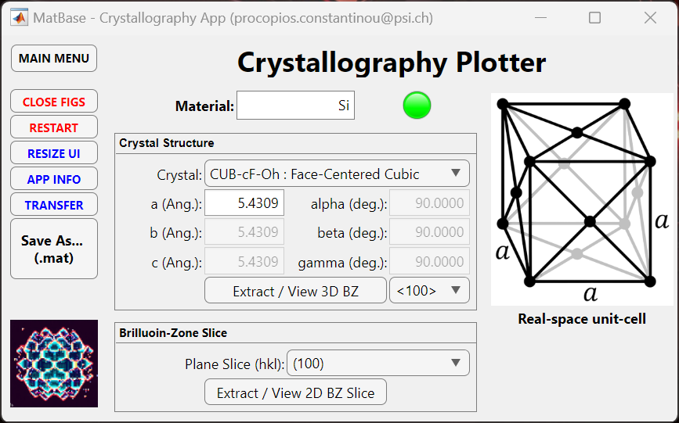
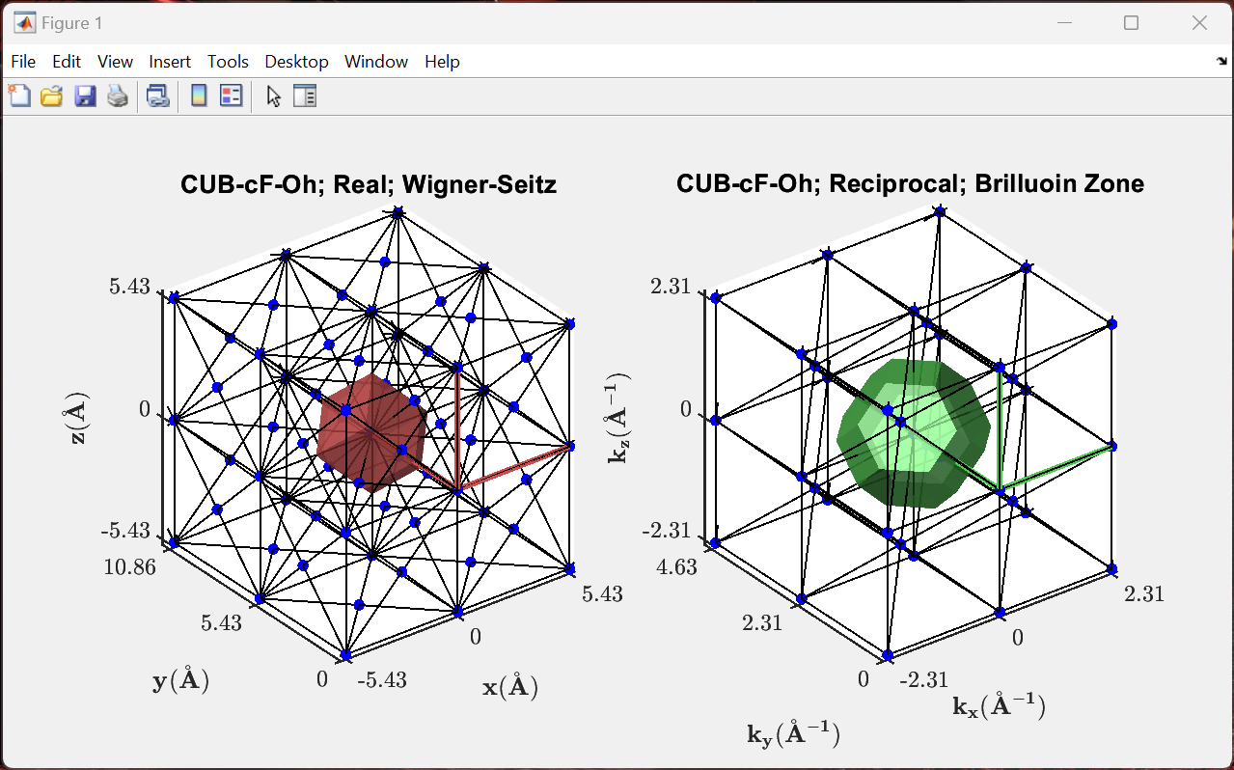
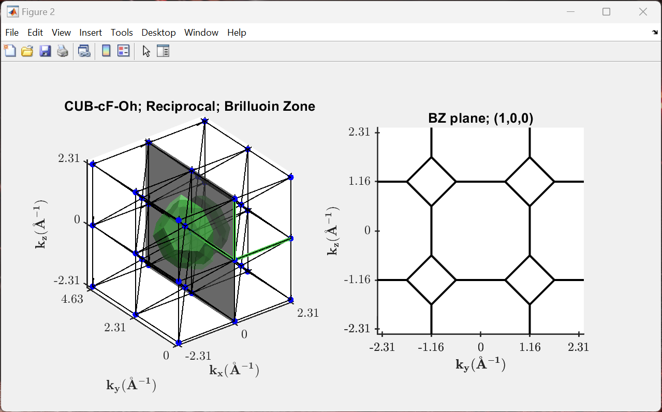
Crystallography App
Access all material parameters from the database or manually enter the crystal-structure and lattice vectors.
Plot the 3D real- and reciprocal-space lattices.
Extract 2D slices through the Brillouin zone.

Slide 4
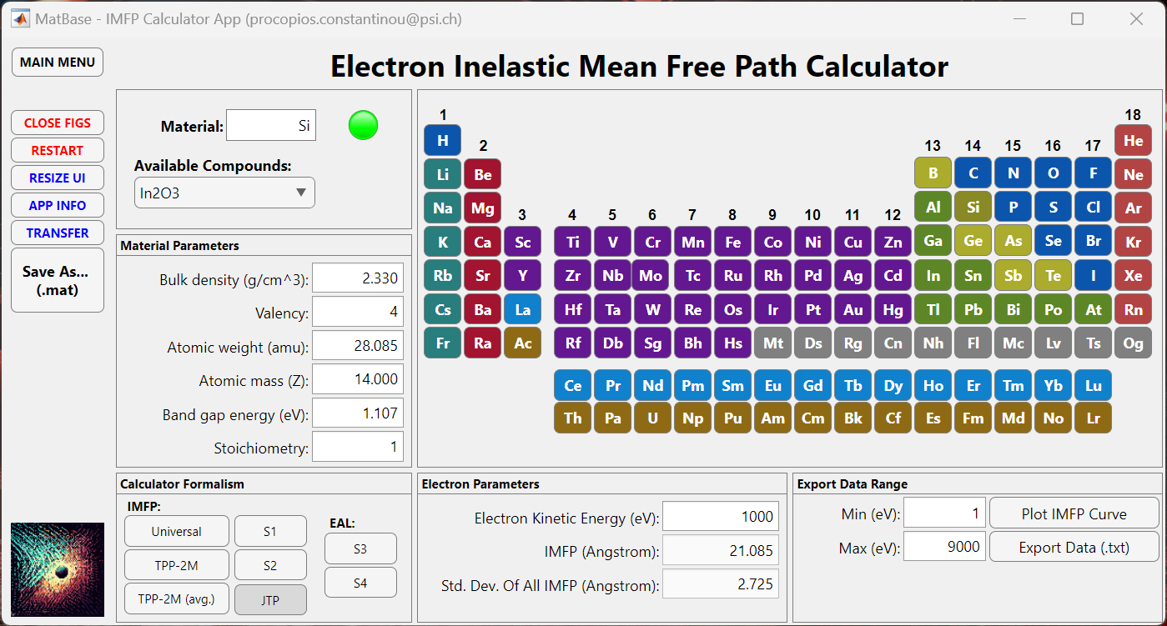
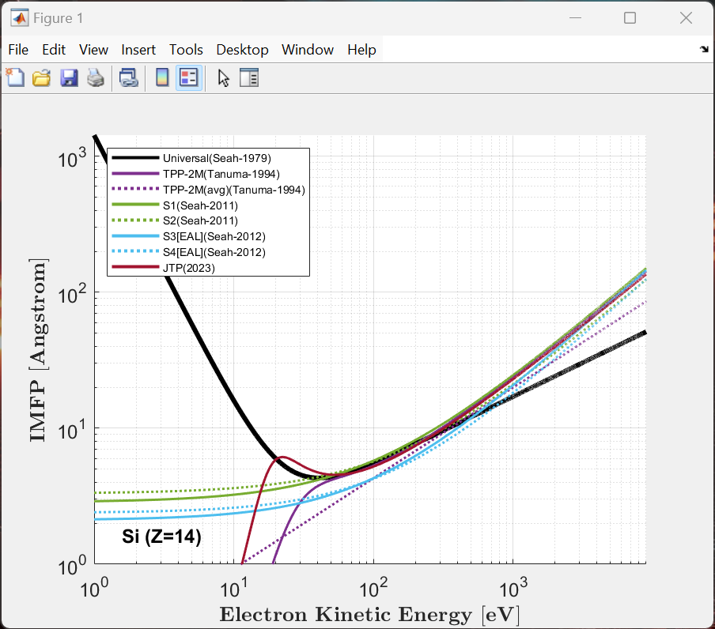
IMFP Calculator App
Access all material parameters from the database or manually enter data for materials not included.
Plot and calculate the IMFP using a range of formalisms; Universal, TPP-2M, S1, S2, S3, S4 & JTP methods.
Export IMFP data versus kinetic energy as a text file.
Use ‘calc_imfp()’ in MATLAB as a general IMFP calculator function.

Slide 5
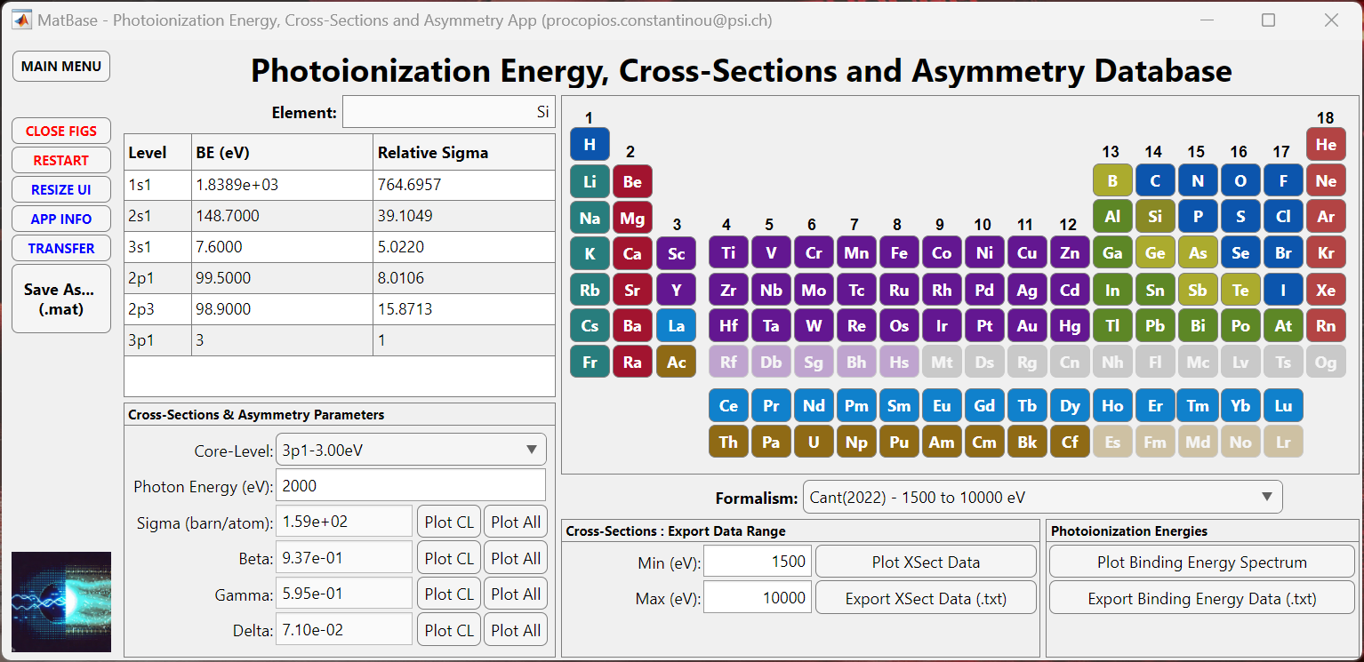
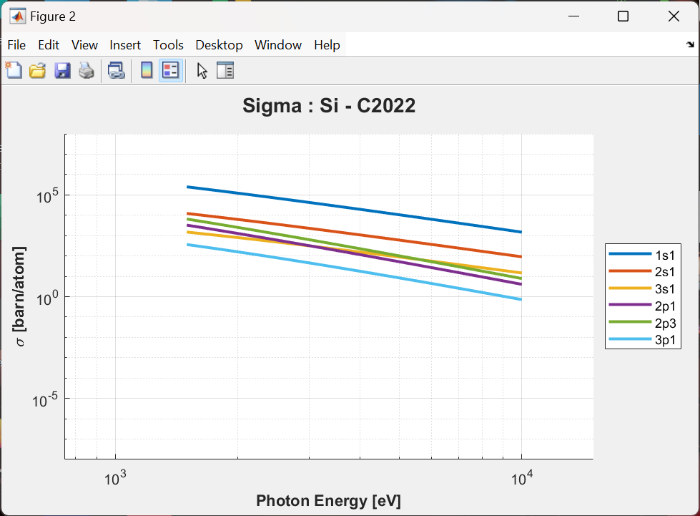
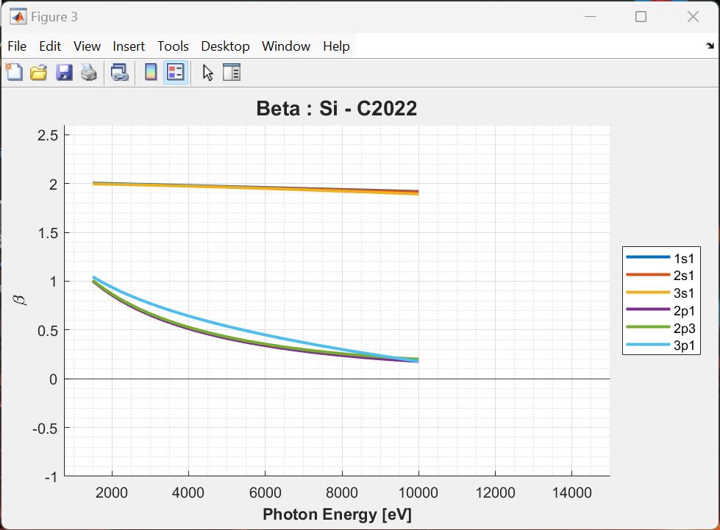
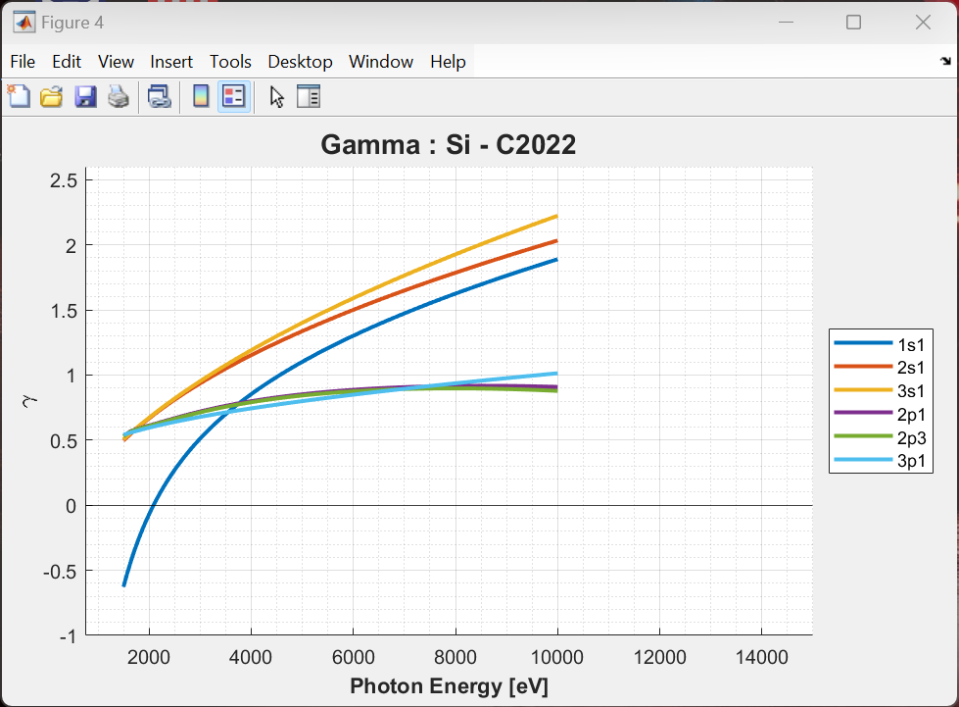
Photoionization App
Elements 1 – 103 available.
Plot the binding energy spectrum, photoionization cross-sections, and photoionization asymmetry parameters.
Easily identify the best core-levels to probe by finding the maximum cross-sections.
Data from 4 different formalisms: Scofield (1973), Yeh & Lindau (1985), Trzhaskovskaya (2018) and Cant (2022).
Export any of the photoionization parameters as a text file.

Slide 6
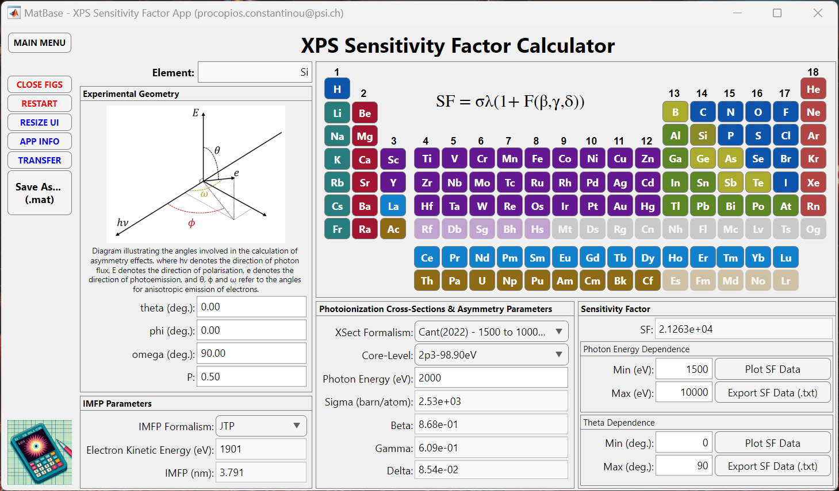
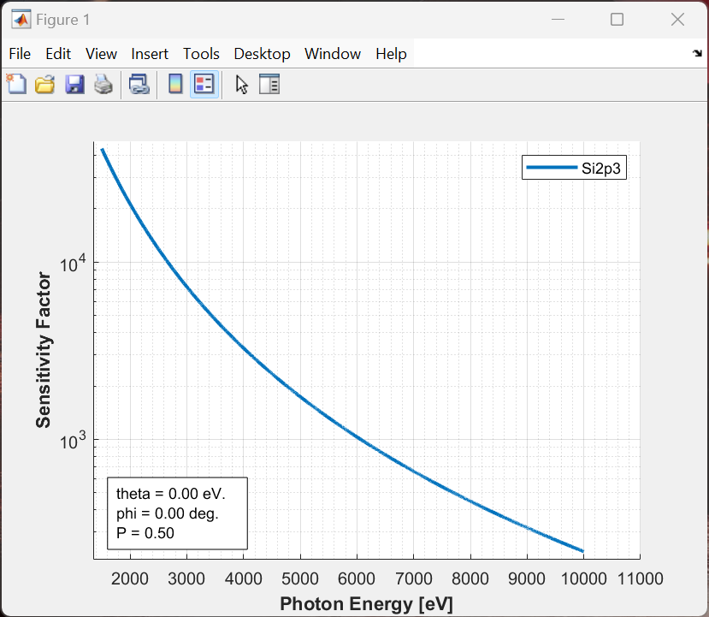
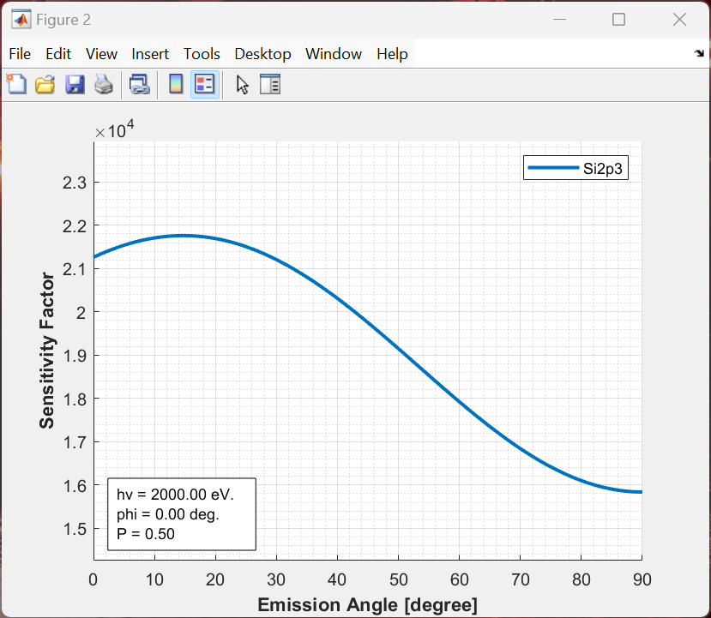
XPS Sensitivity Factor App
Elements 1 – 103 available.
Define your experiment setup and use the IMFP & Photoionization parameters databases to calculate the XPS sensitivity factor
Extract the Sensitivity Factor (SF) for PES quantification
Export the SF data as a text file.

Slide 7
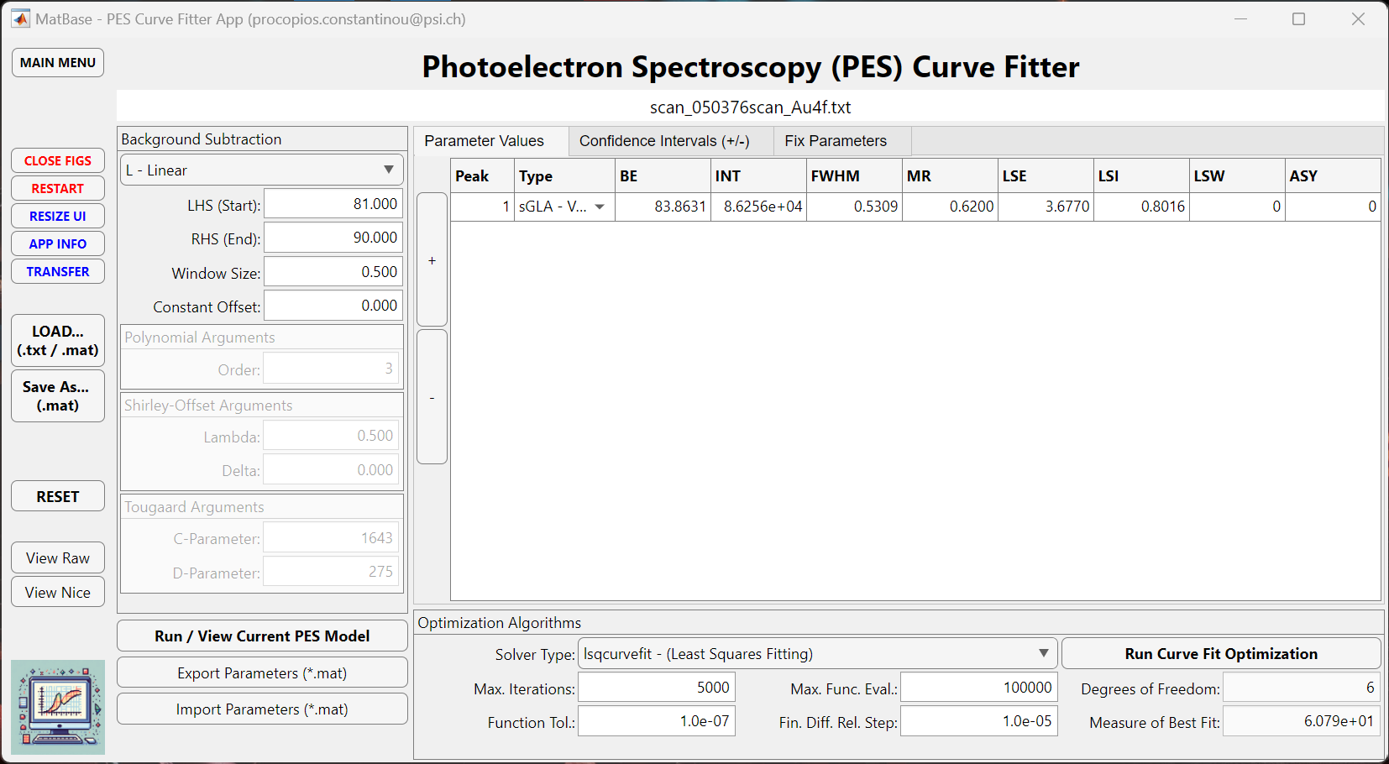
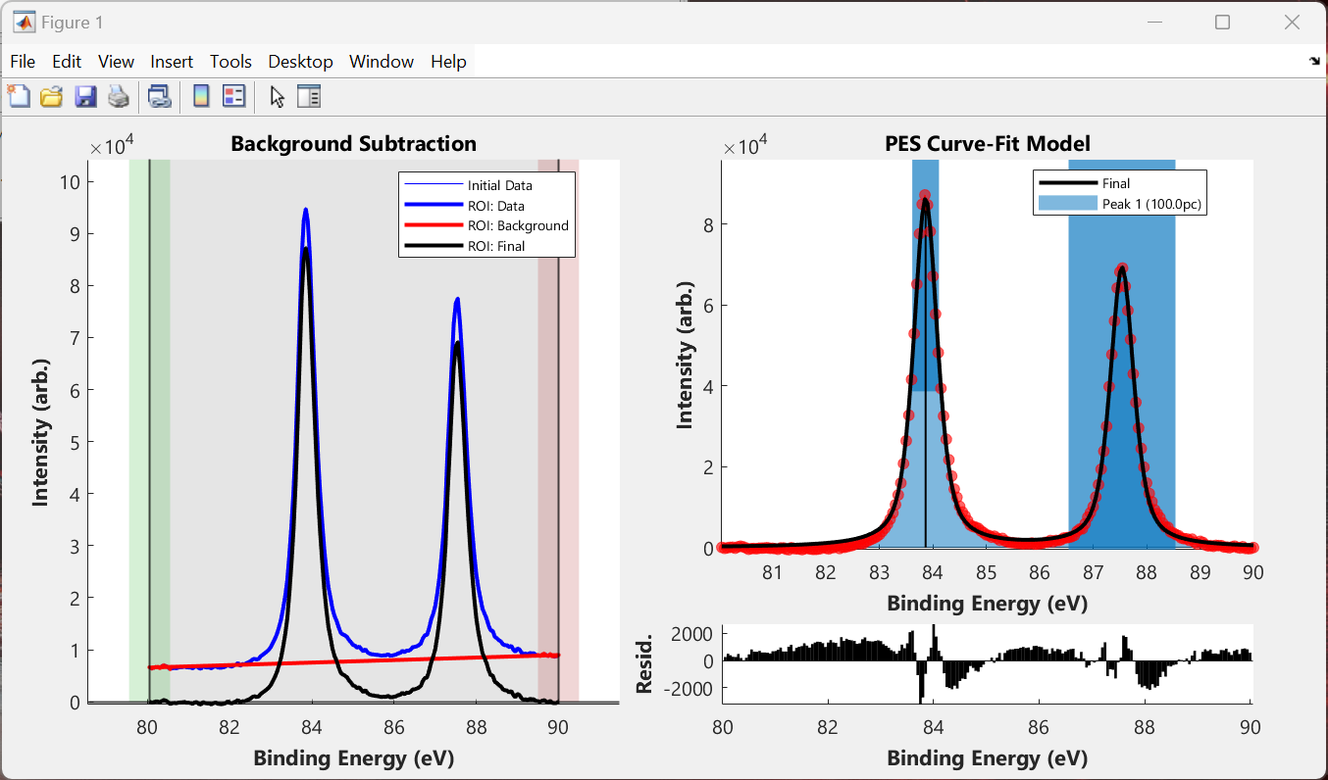
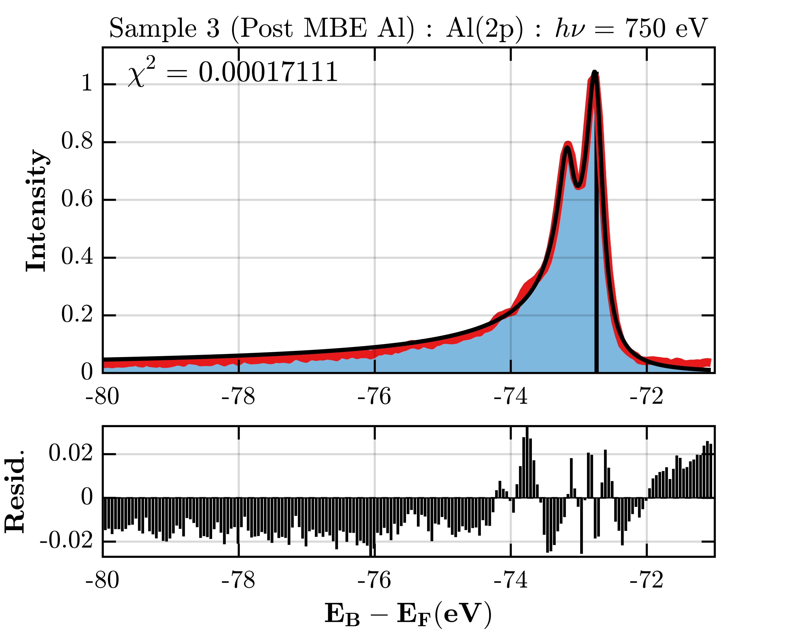
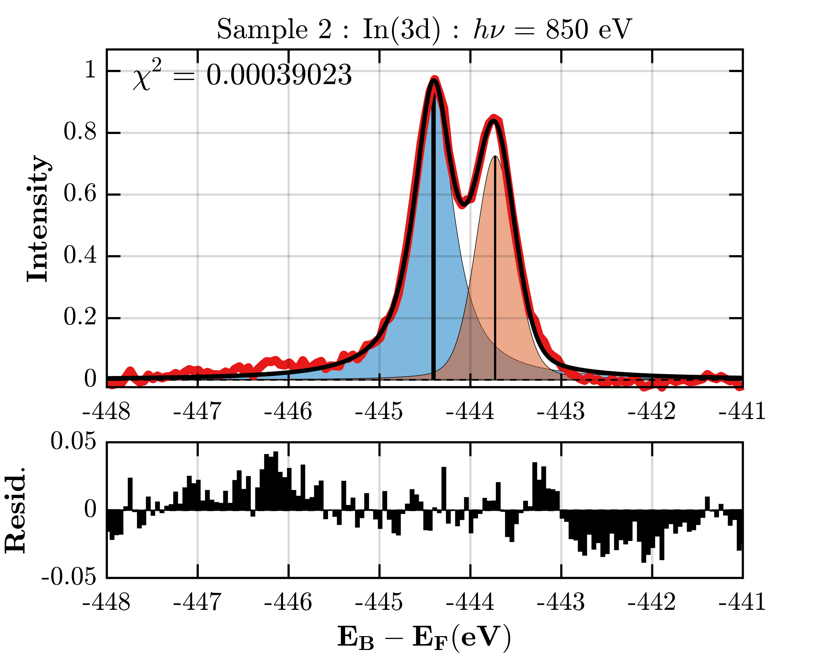
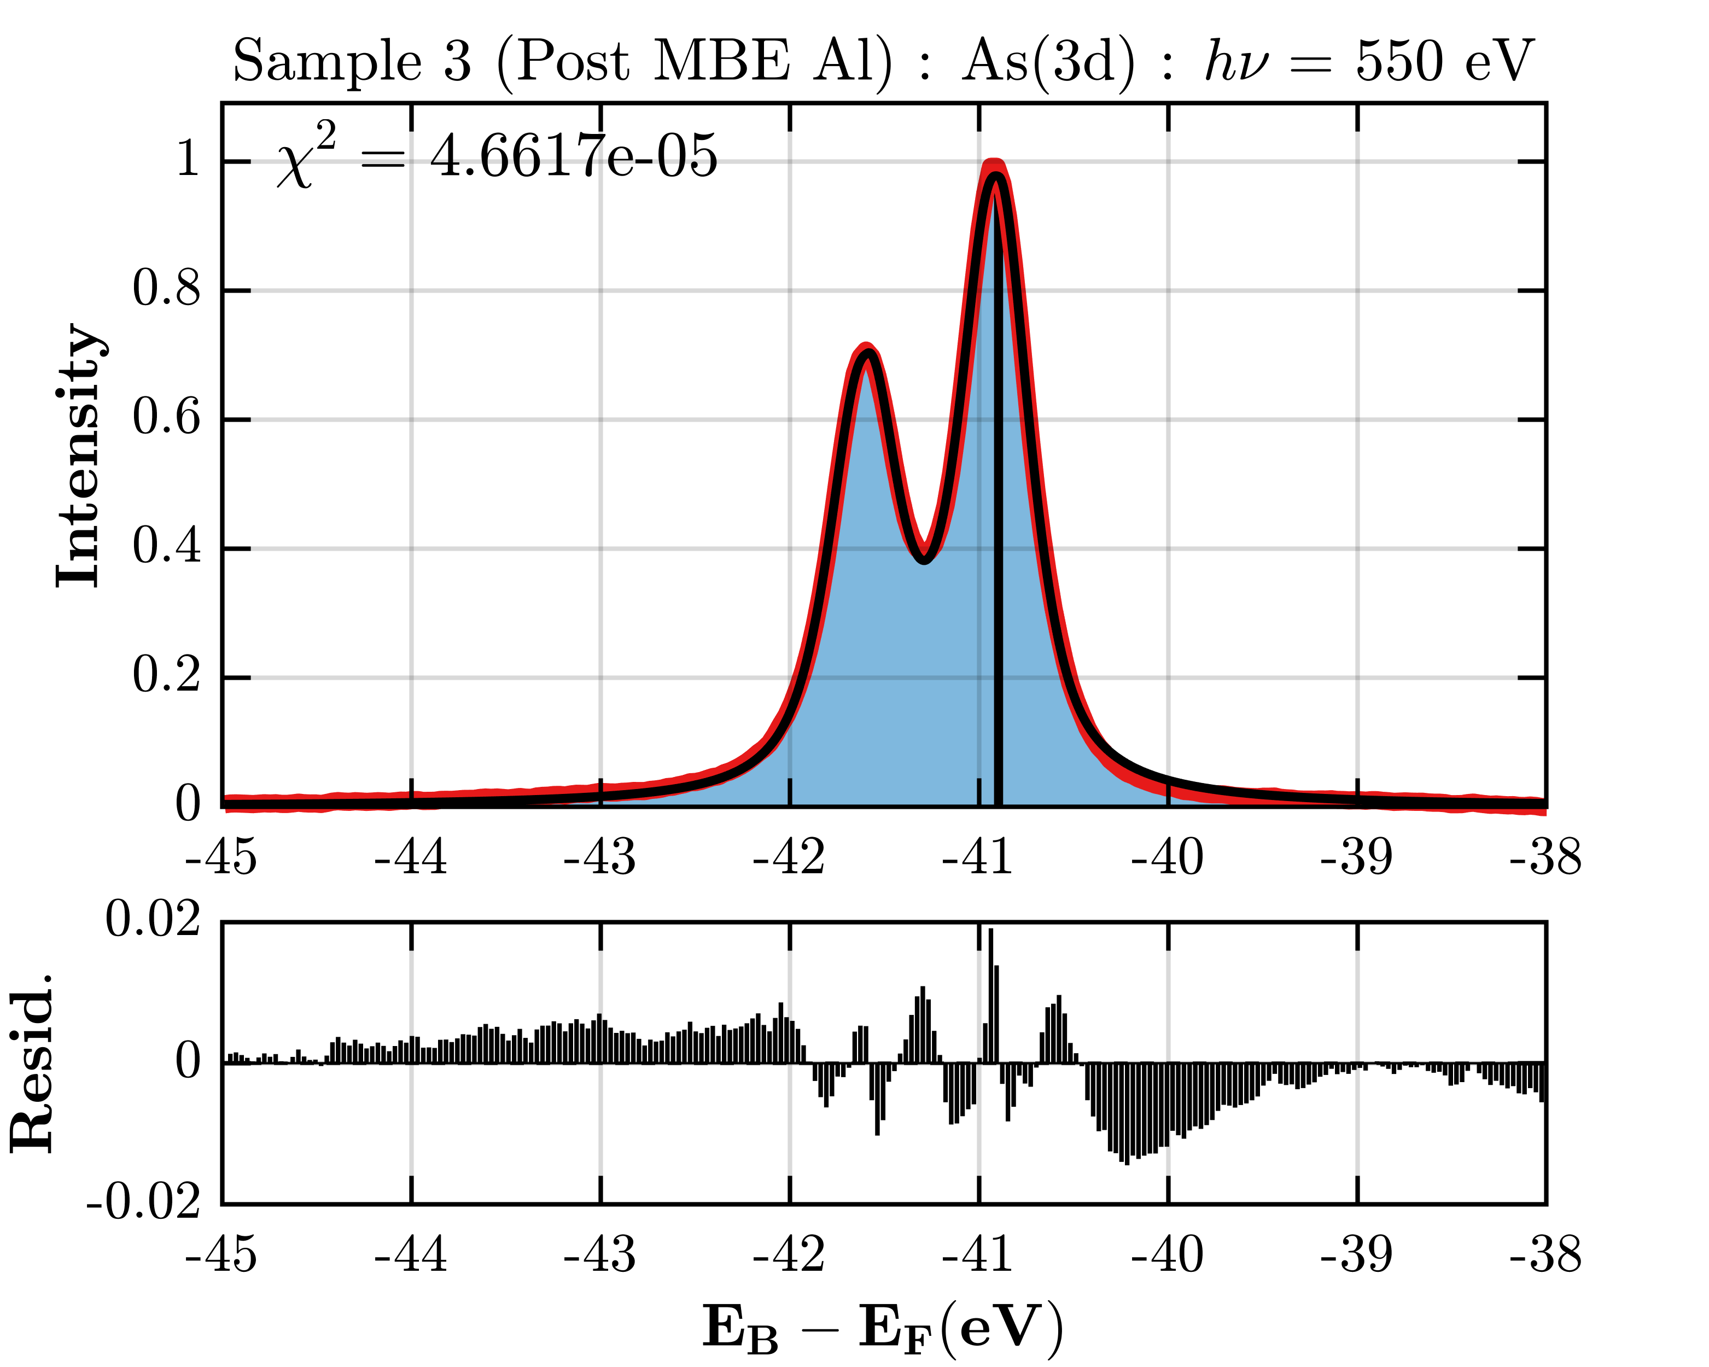
PES Curve Fitting
Au(4f)
Al(2p)
In(3d)
As(3d)
Dedicated UI for curve fitting XPS data.
Background Subtraction: Linear, Shirley, Offset Shirley and Tougaard functions are available.
PES curves: Gaussian, Lorentzian, Voigt, asymmetrical Voigt and Doniach-Sunjic functions are available.
Define an initial PES model and run an optimisation procedure to home into the best fit solution.

Slide 8
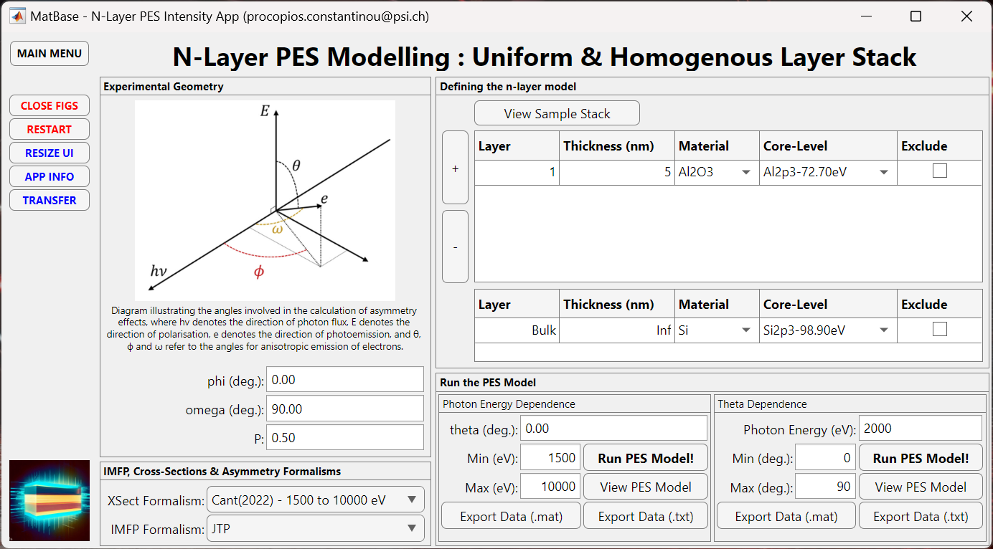
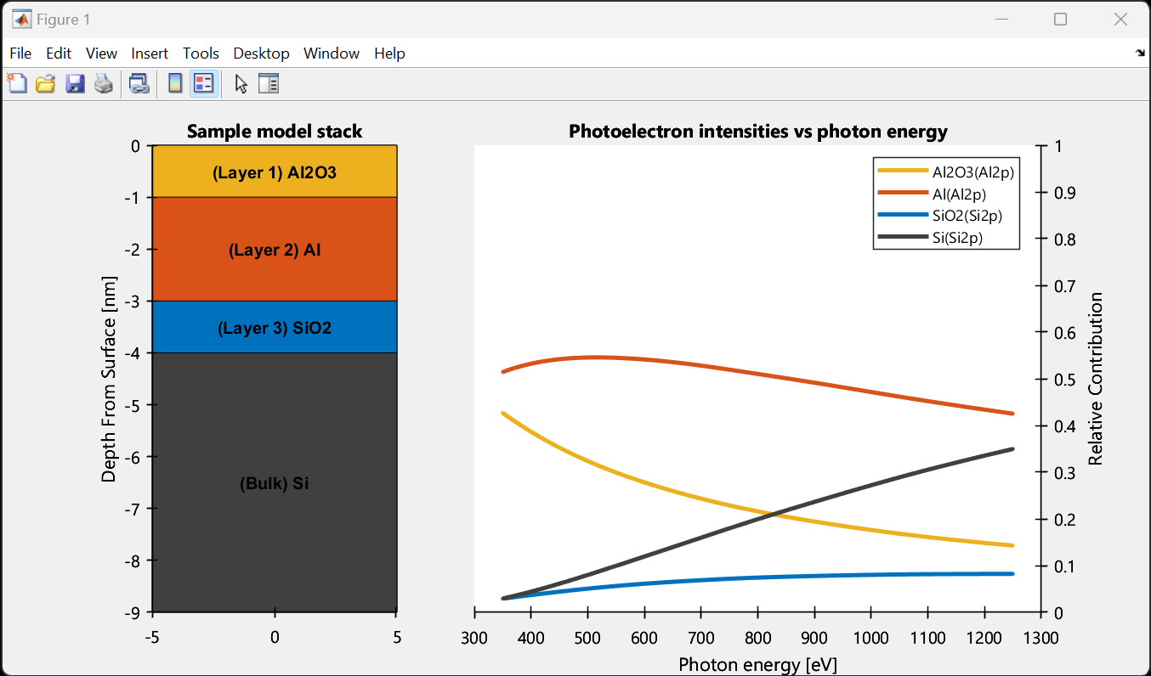
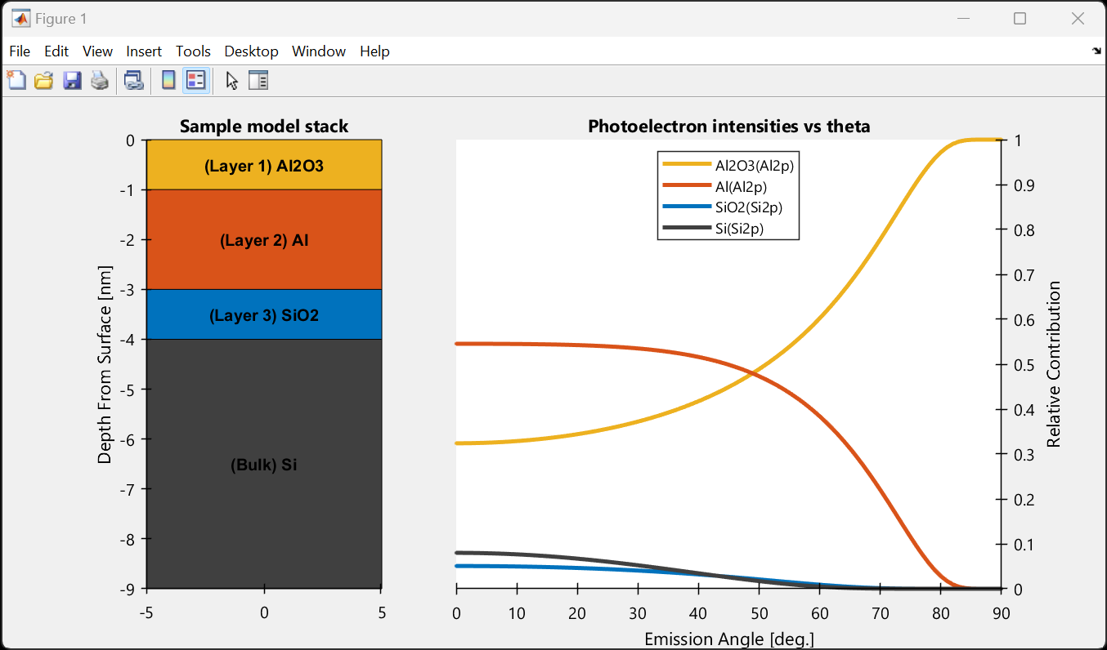
N-Layer PES Modelling
Access all material parameters from our database.
Access to photoionization cross-sections and photoionization asymmetry parameters from our database.
Easily define you N layered sample stack to plot the PES intensities from each layer versus photon energy or emission angle.
Export the data as a text file.

Slide 9
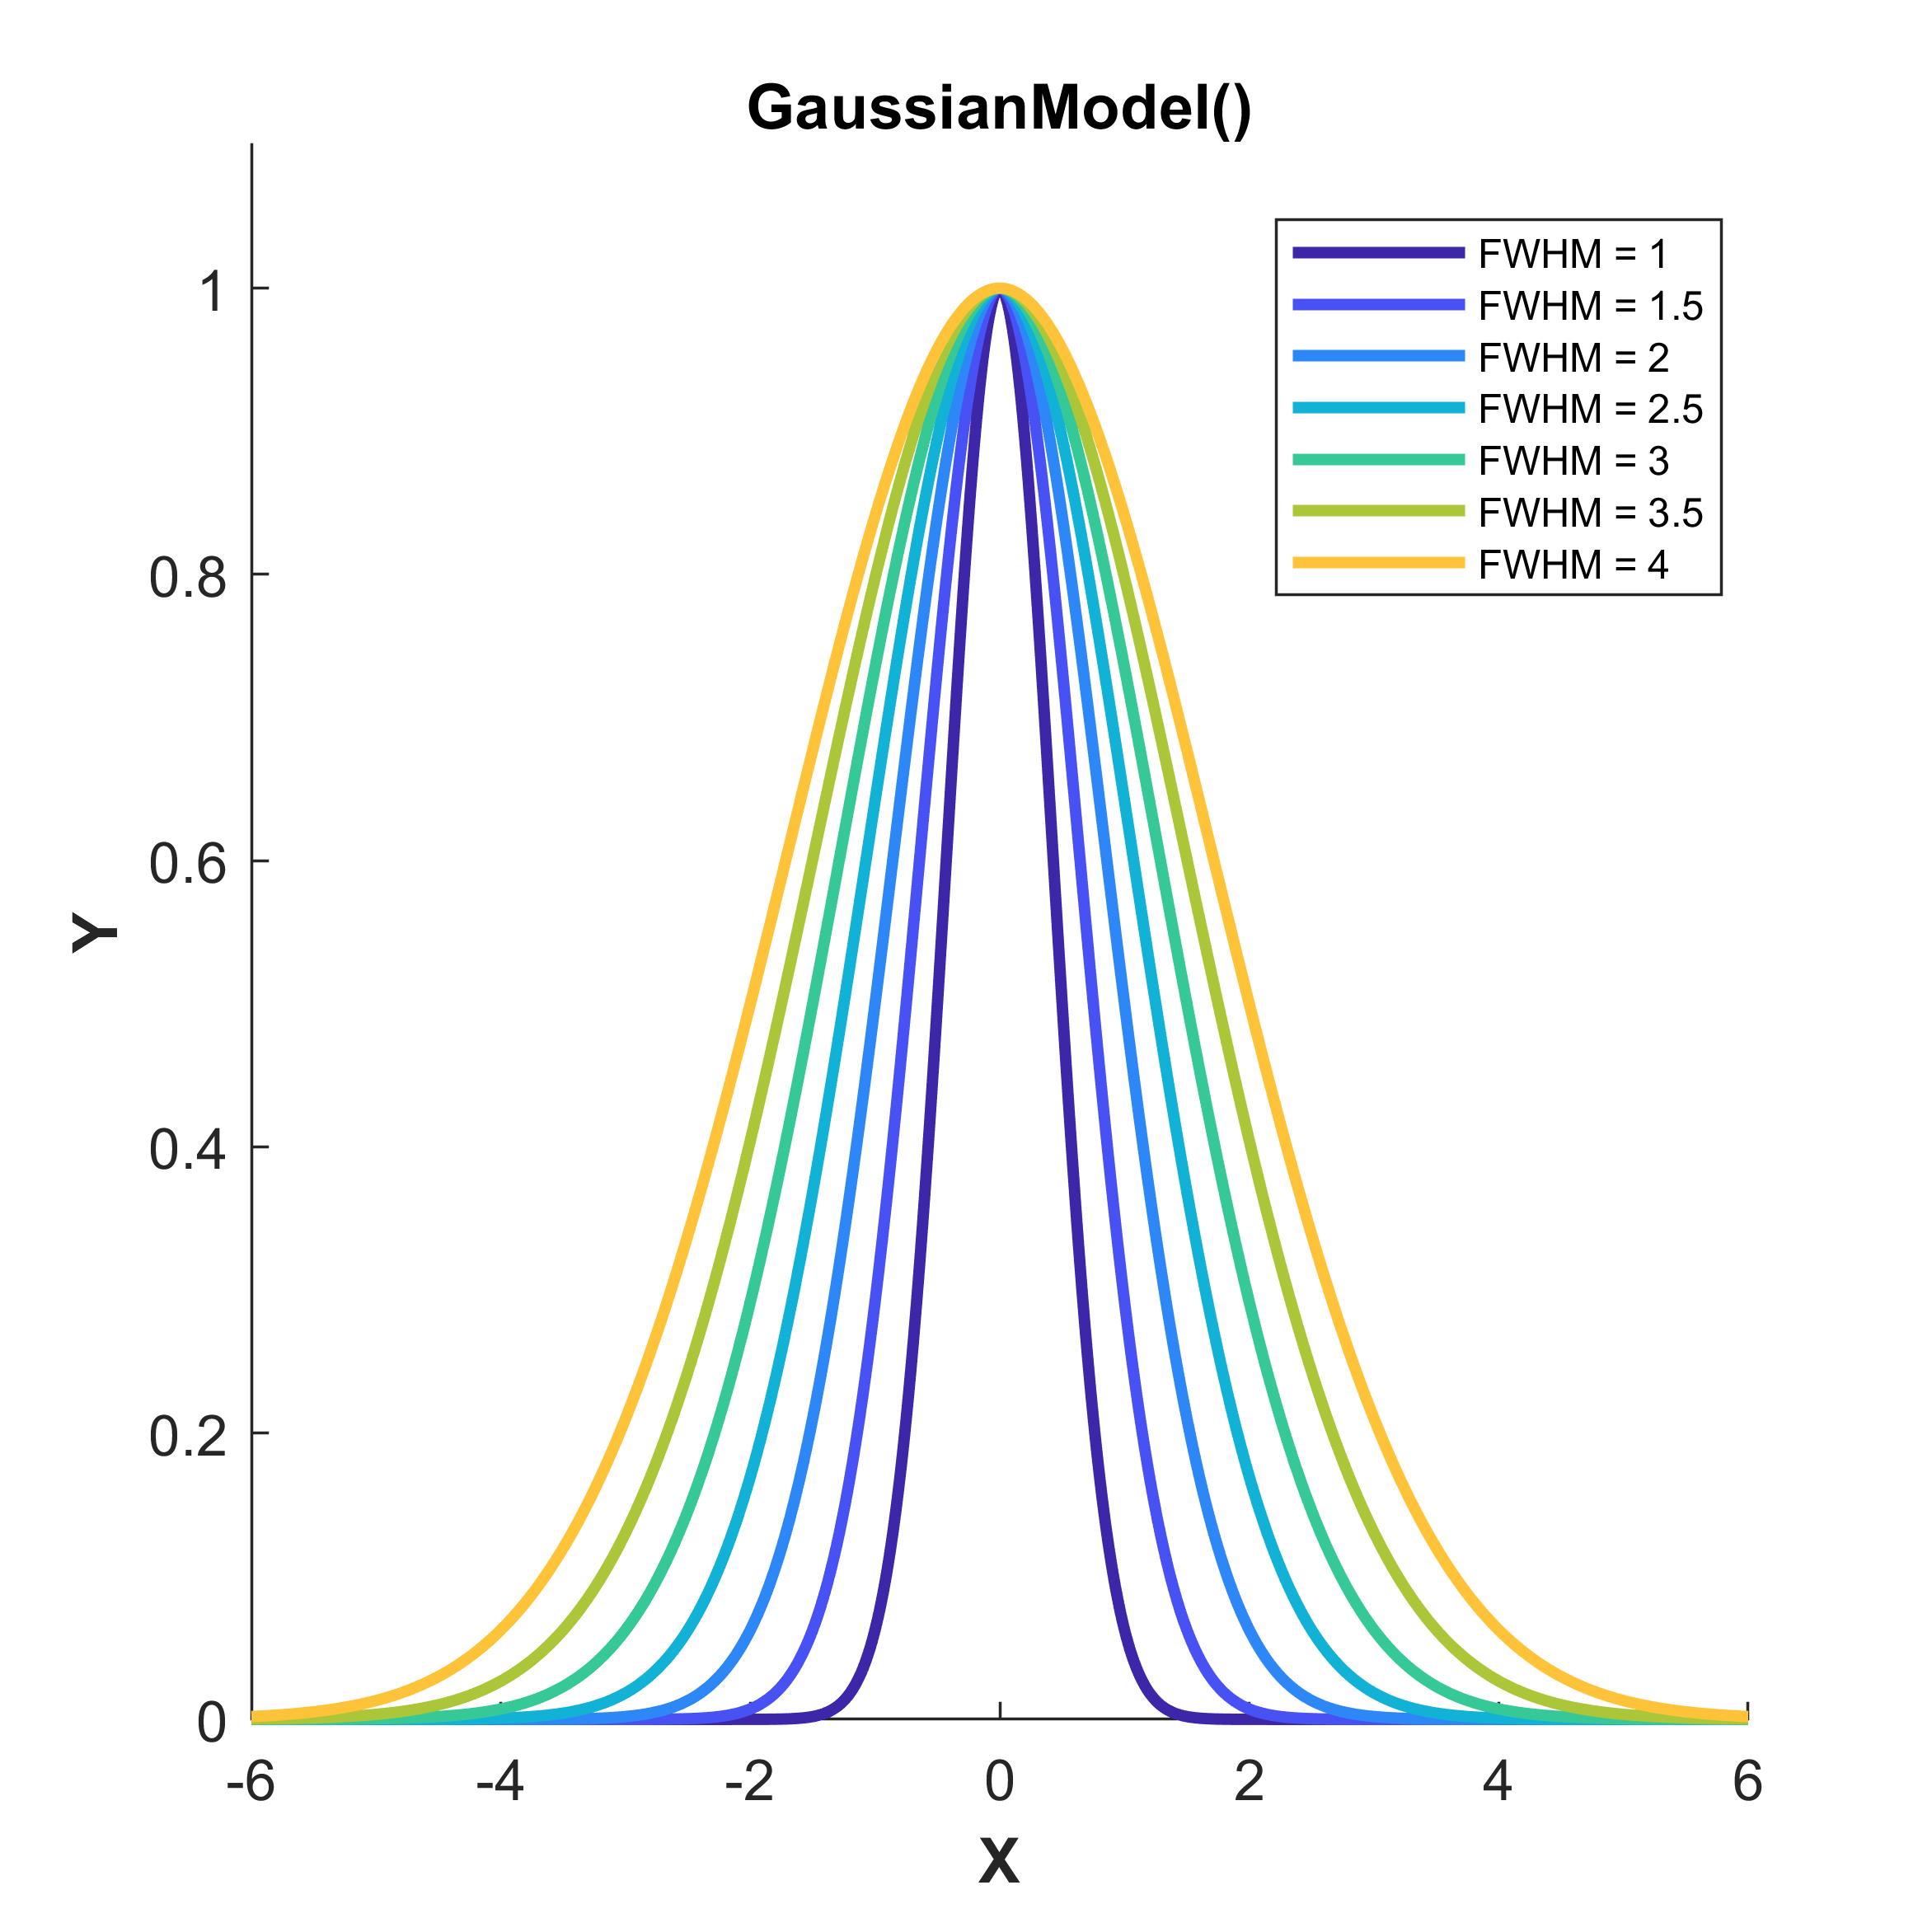
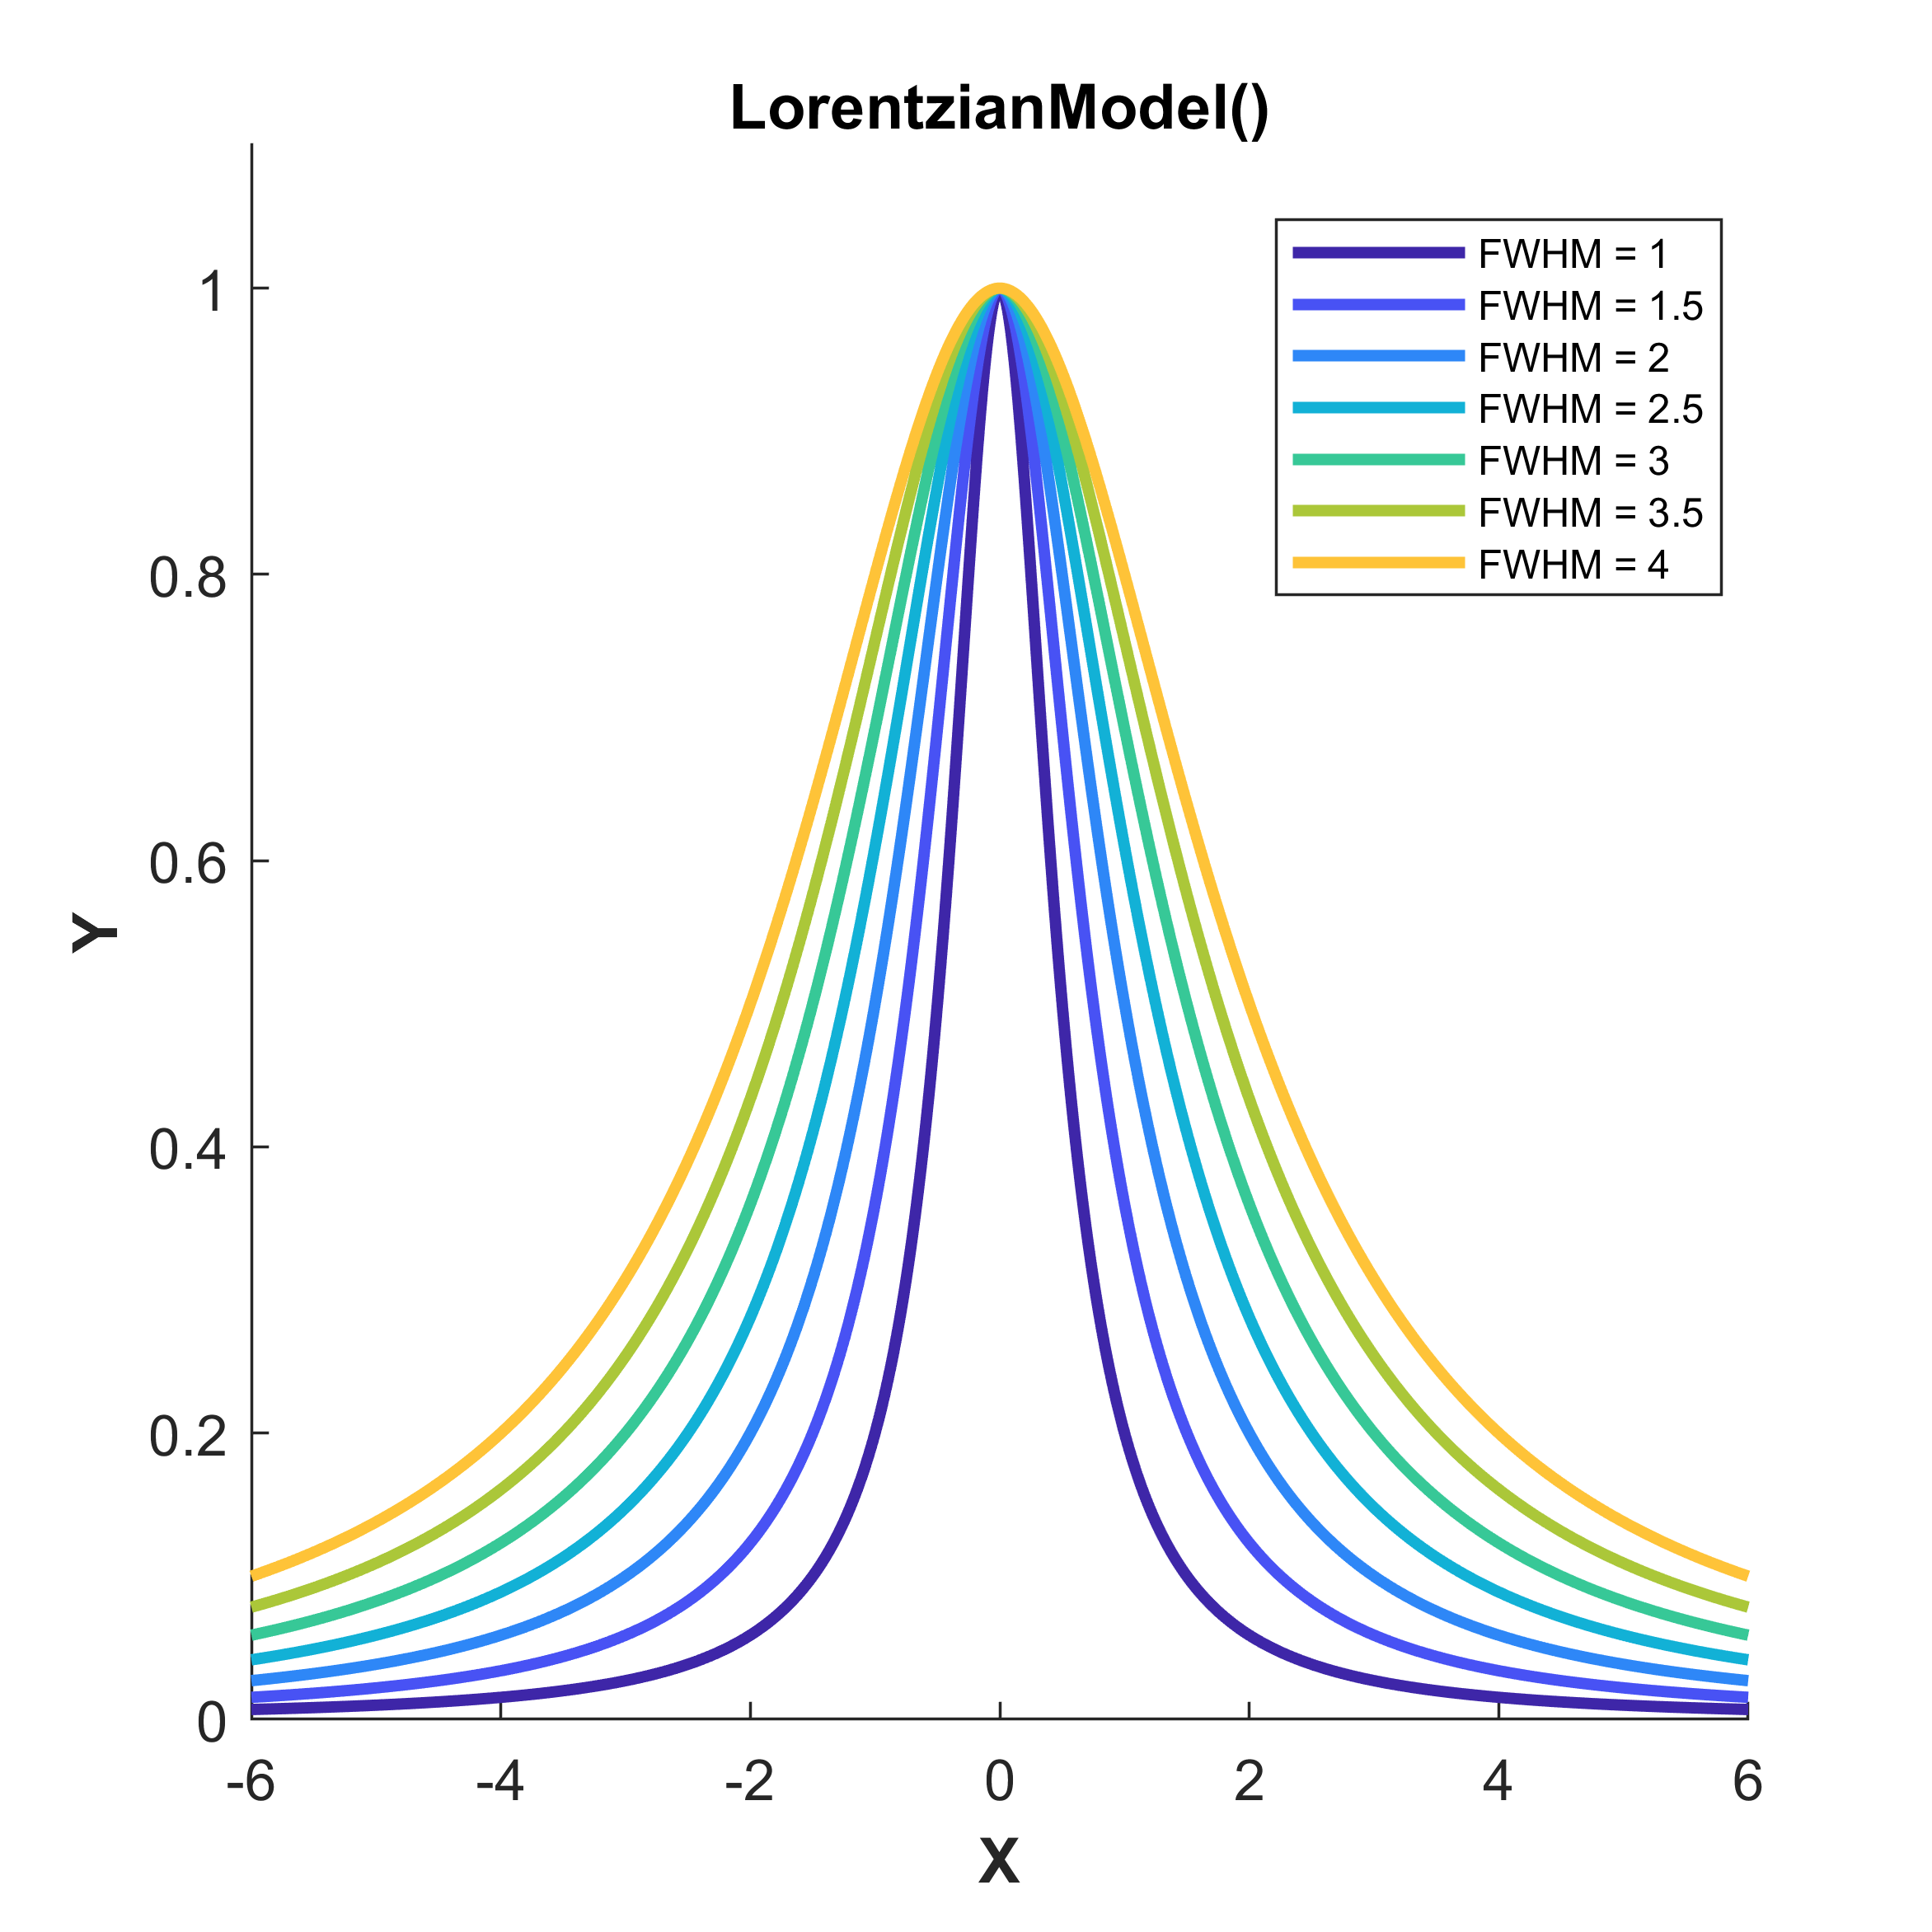
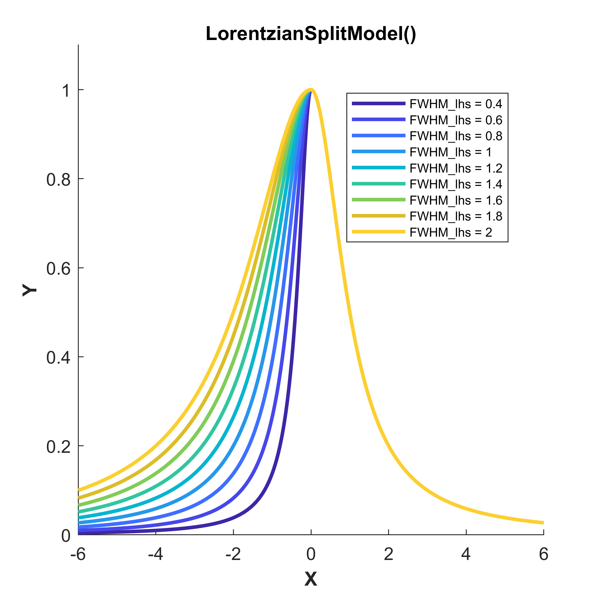
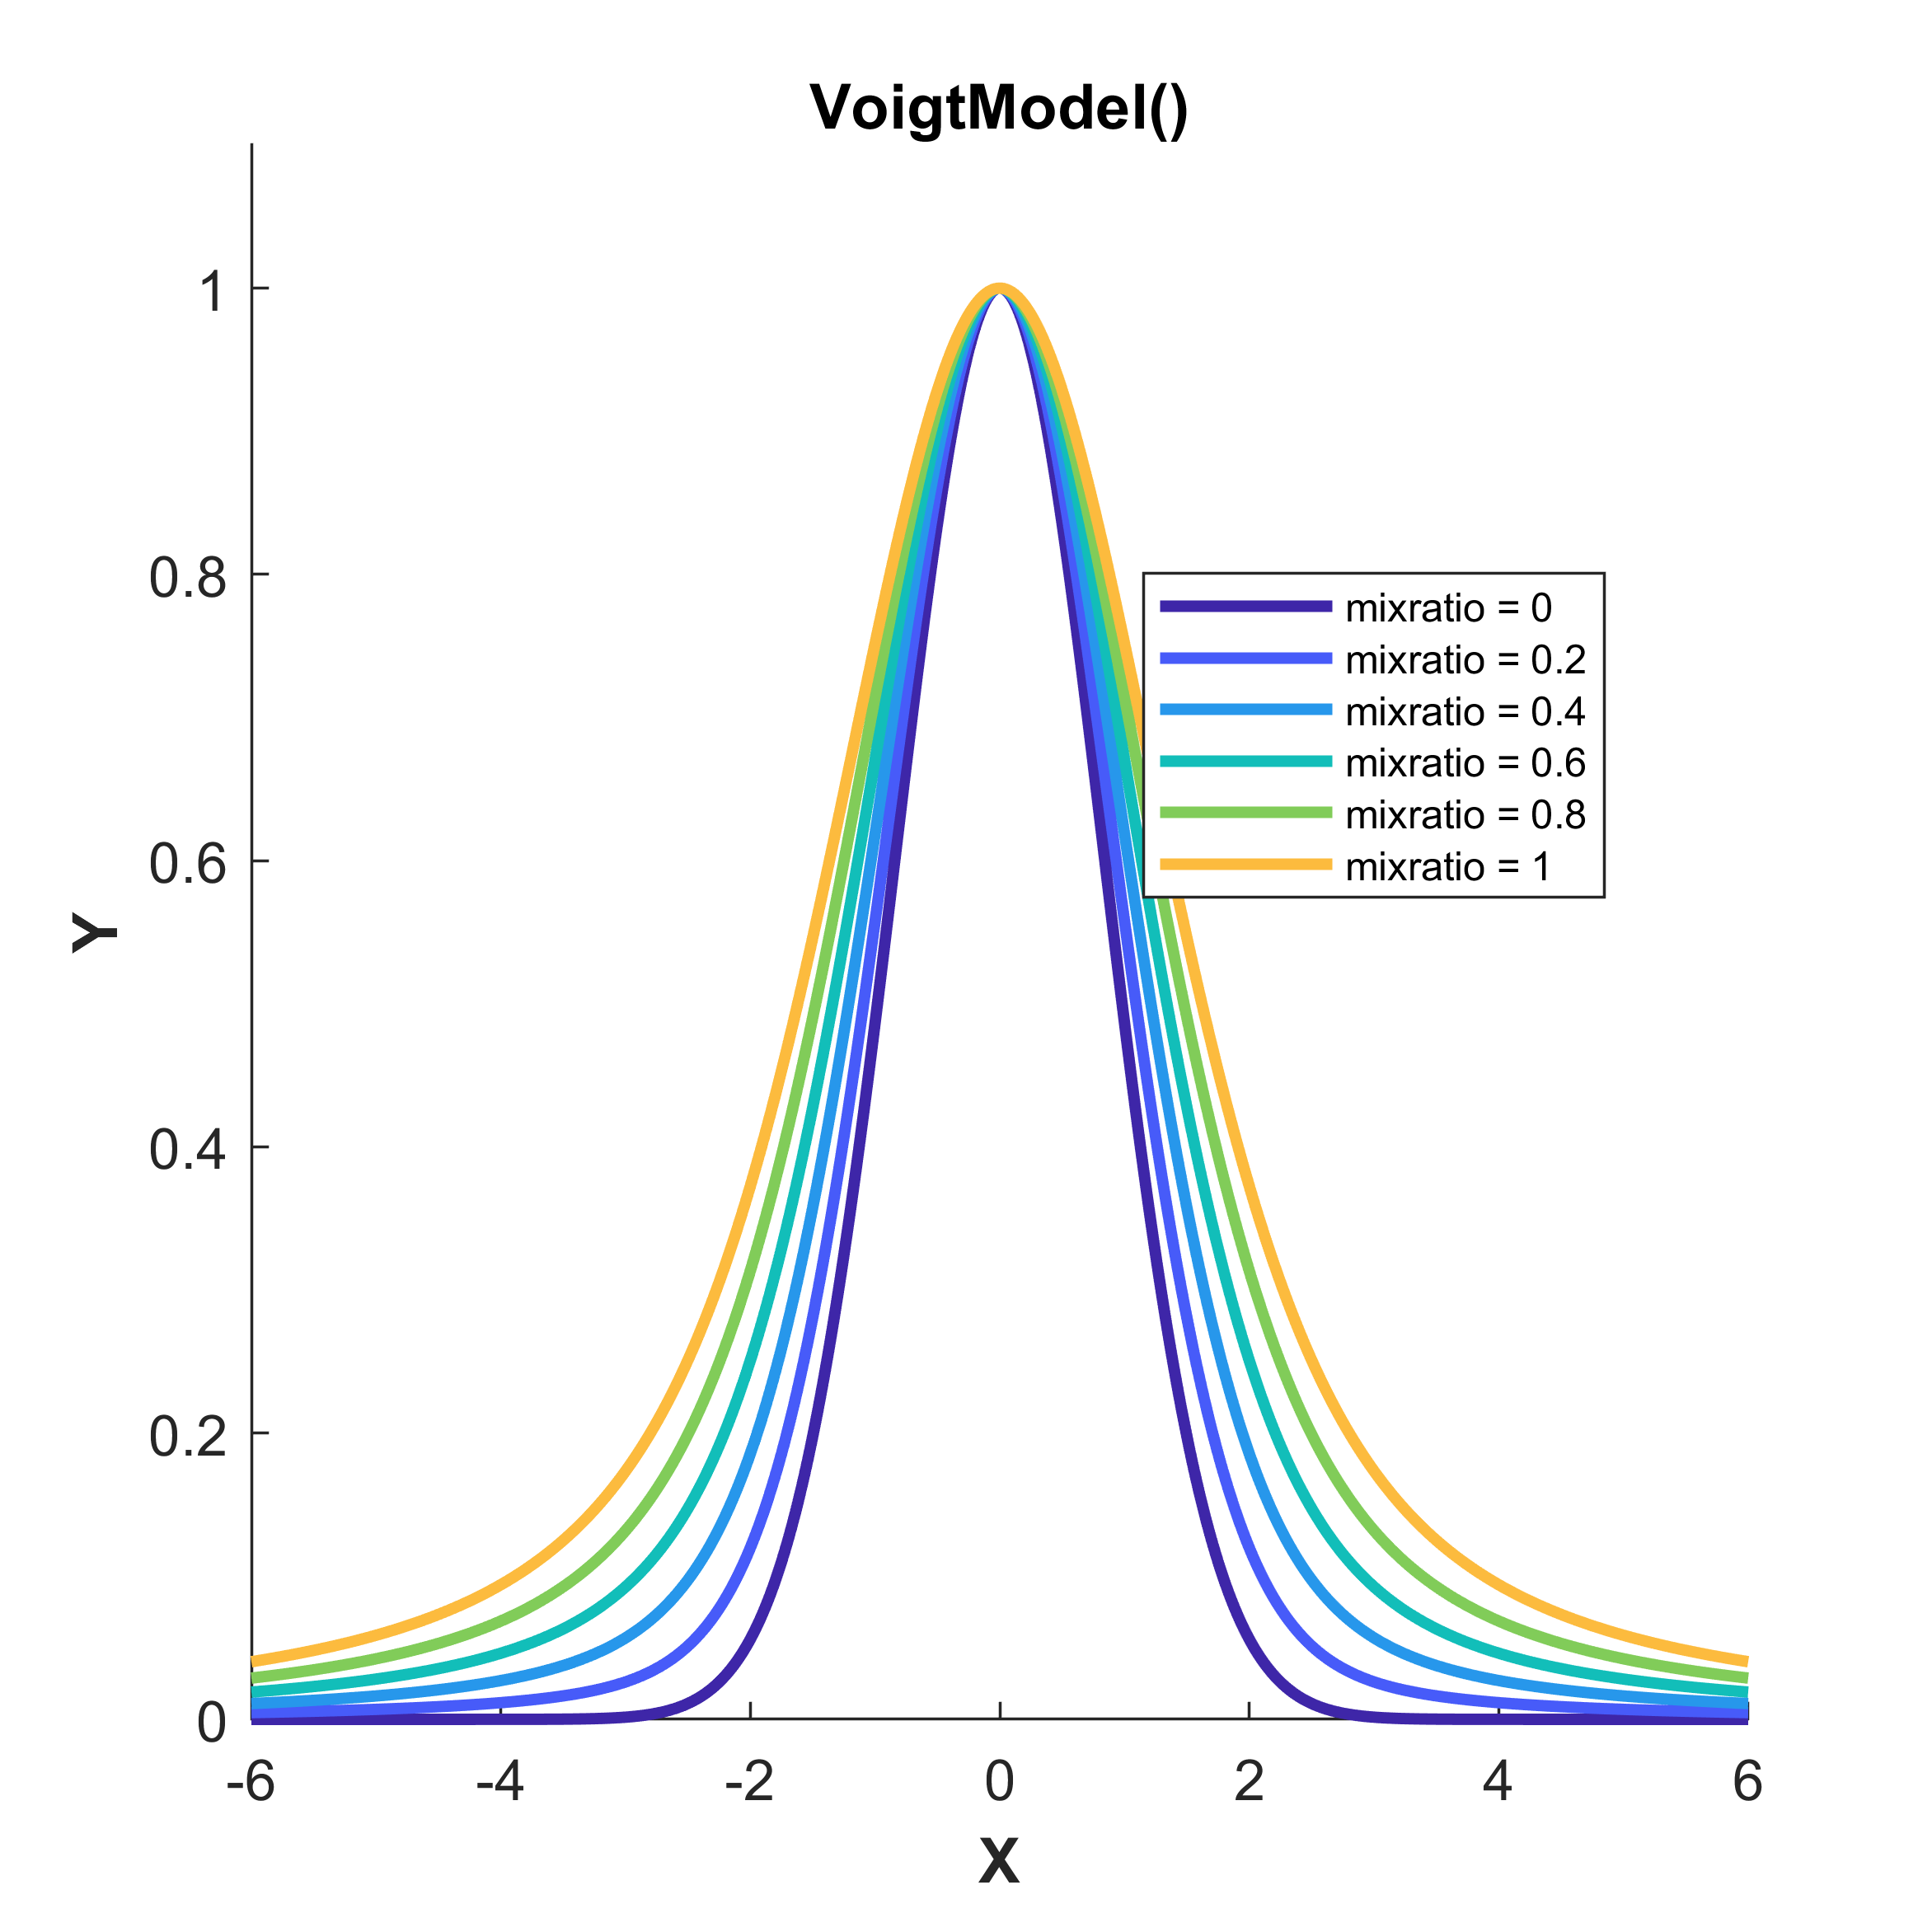
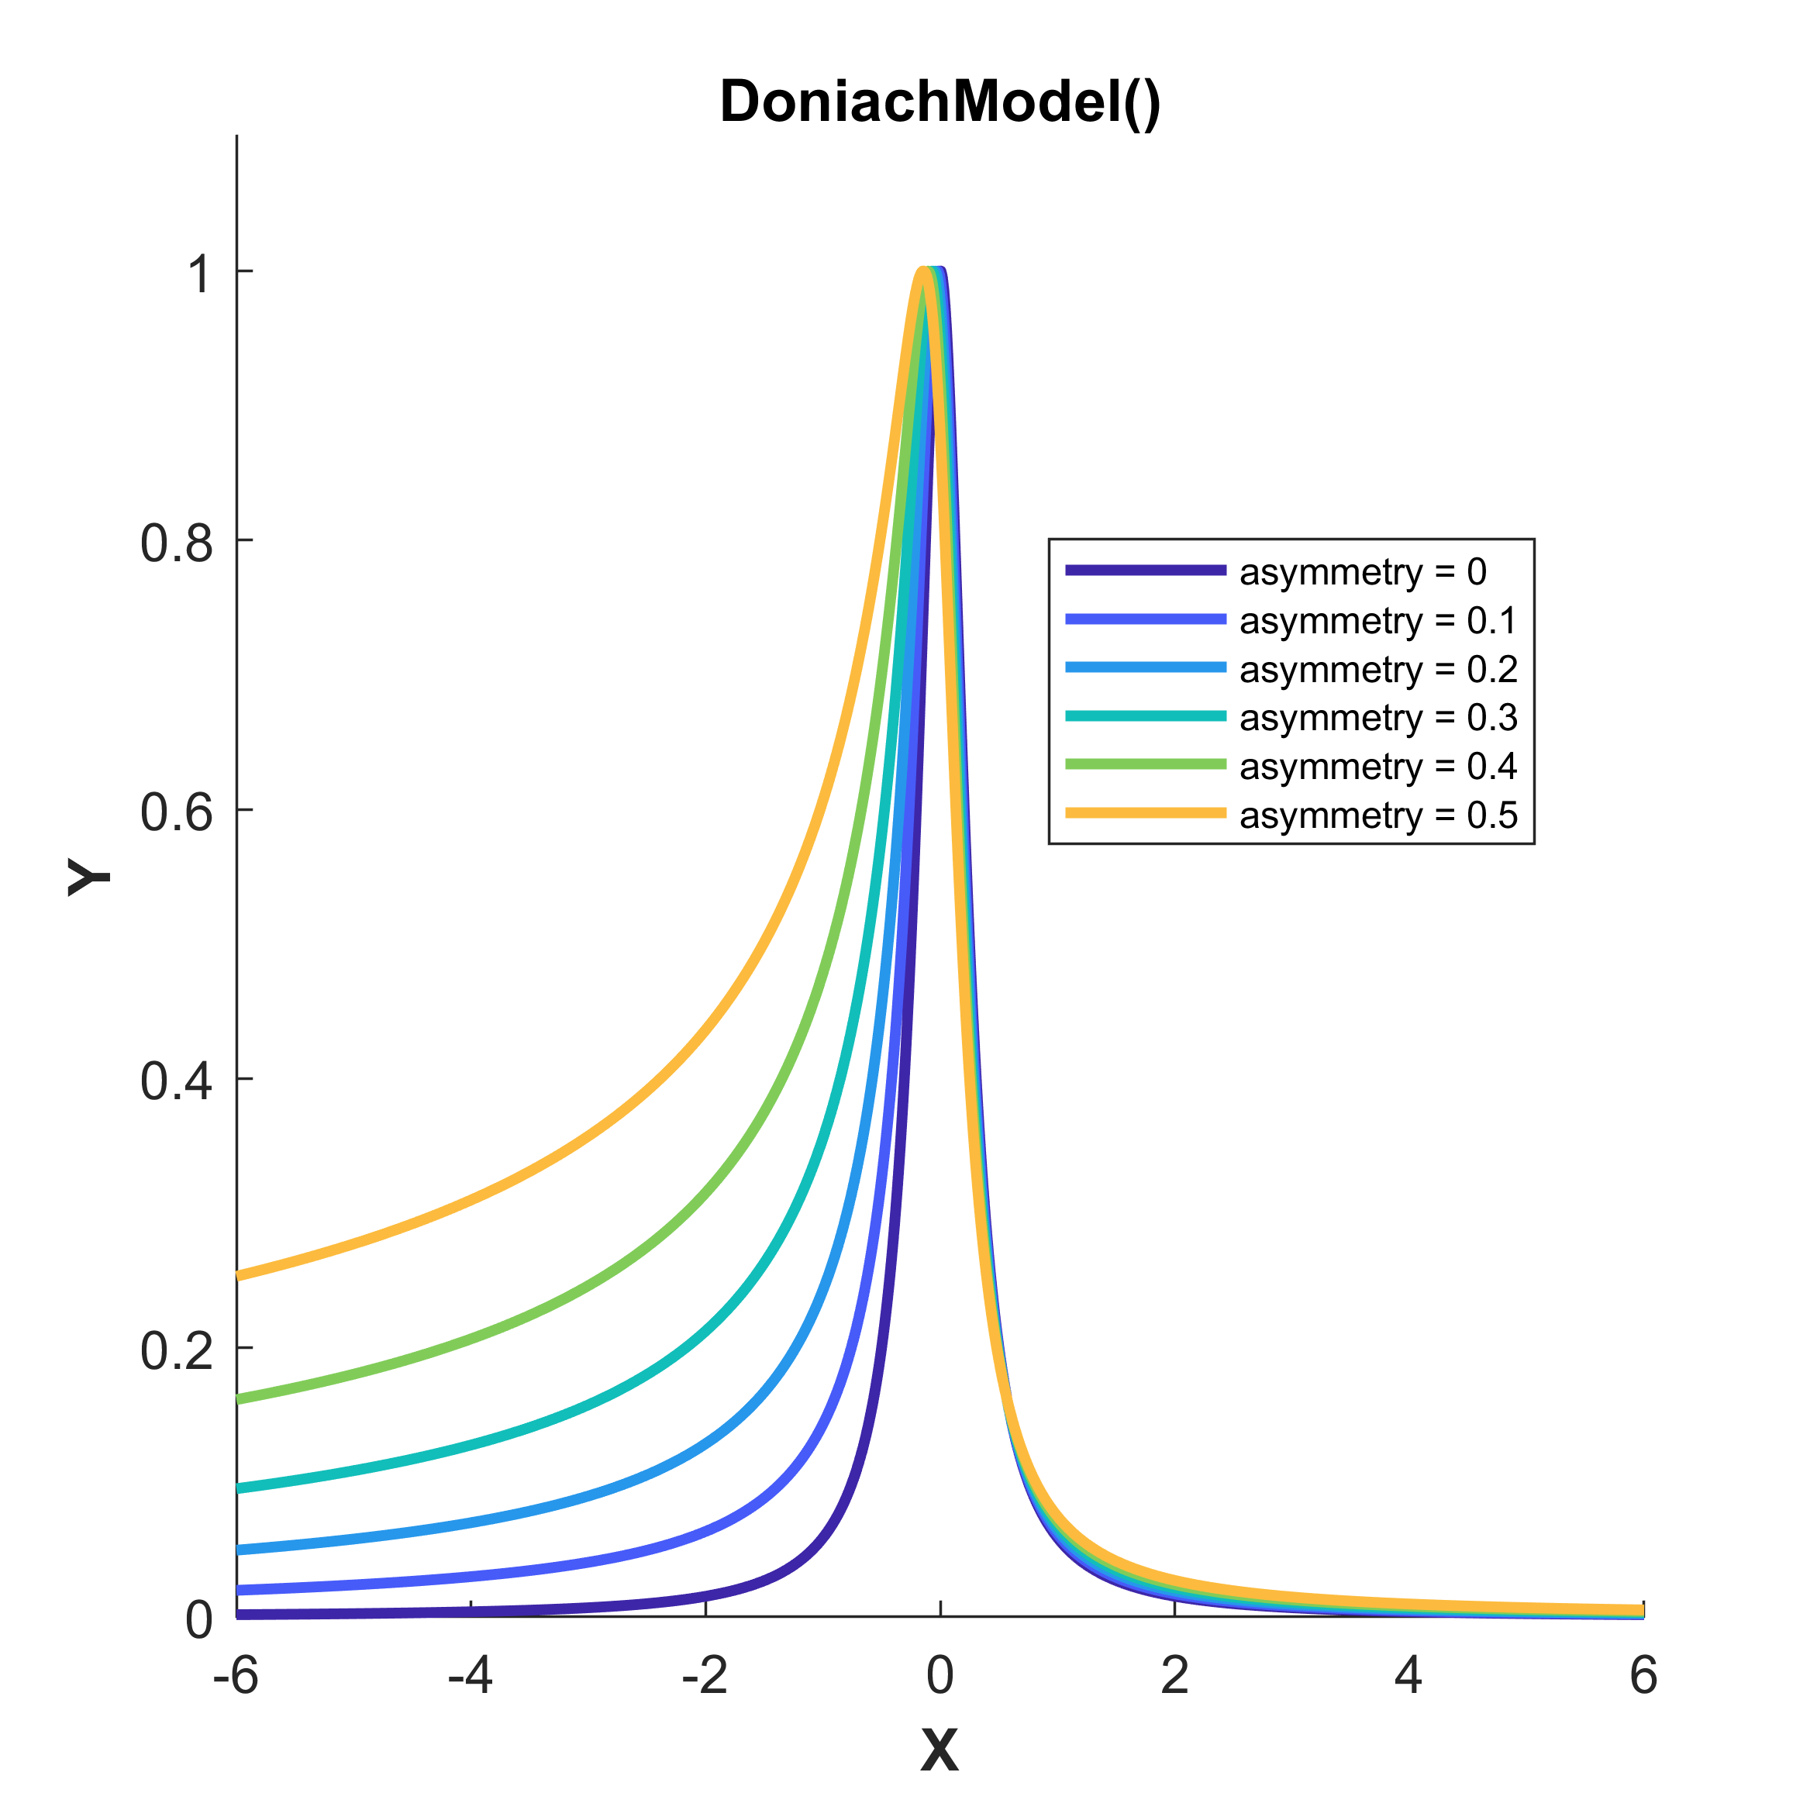
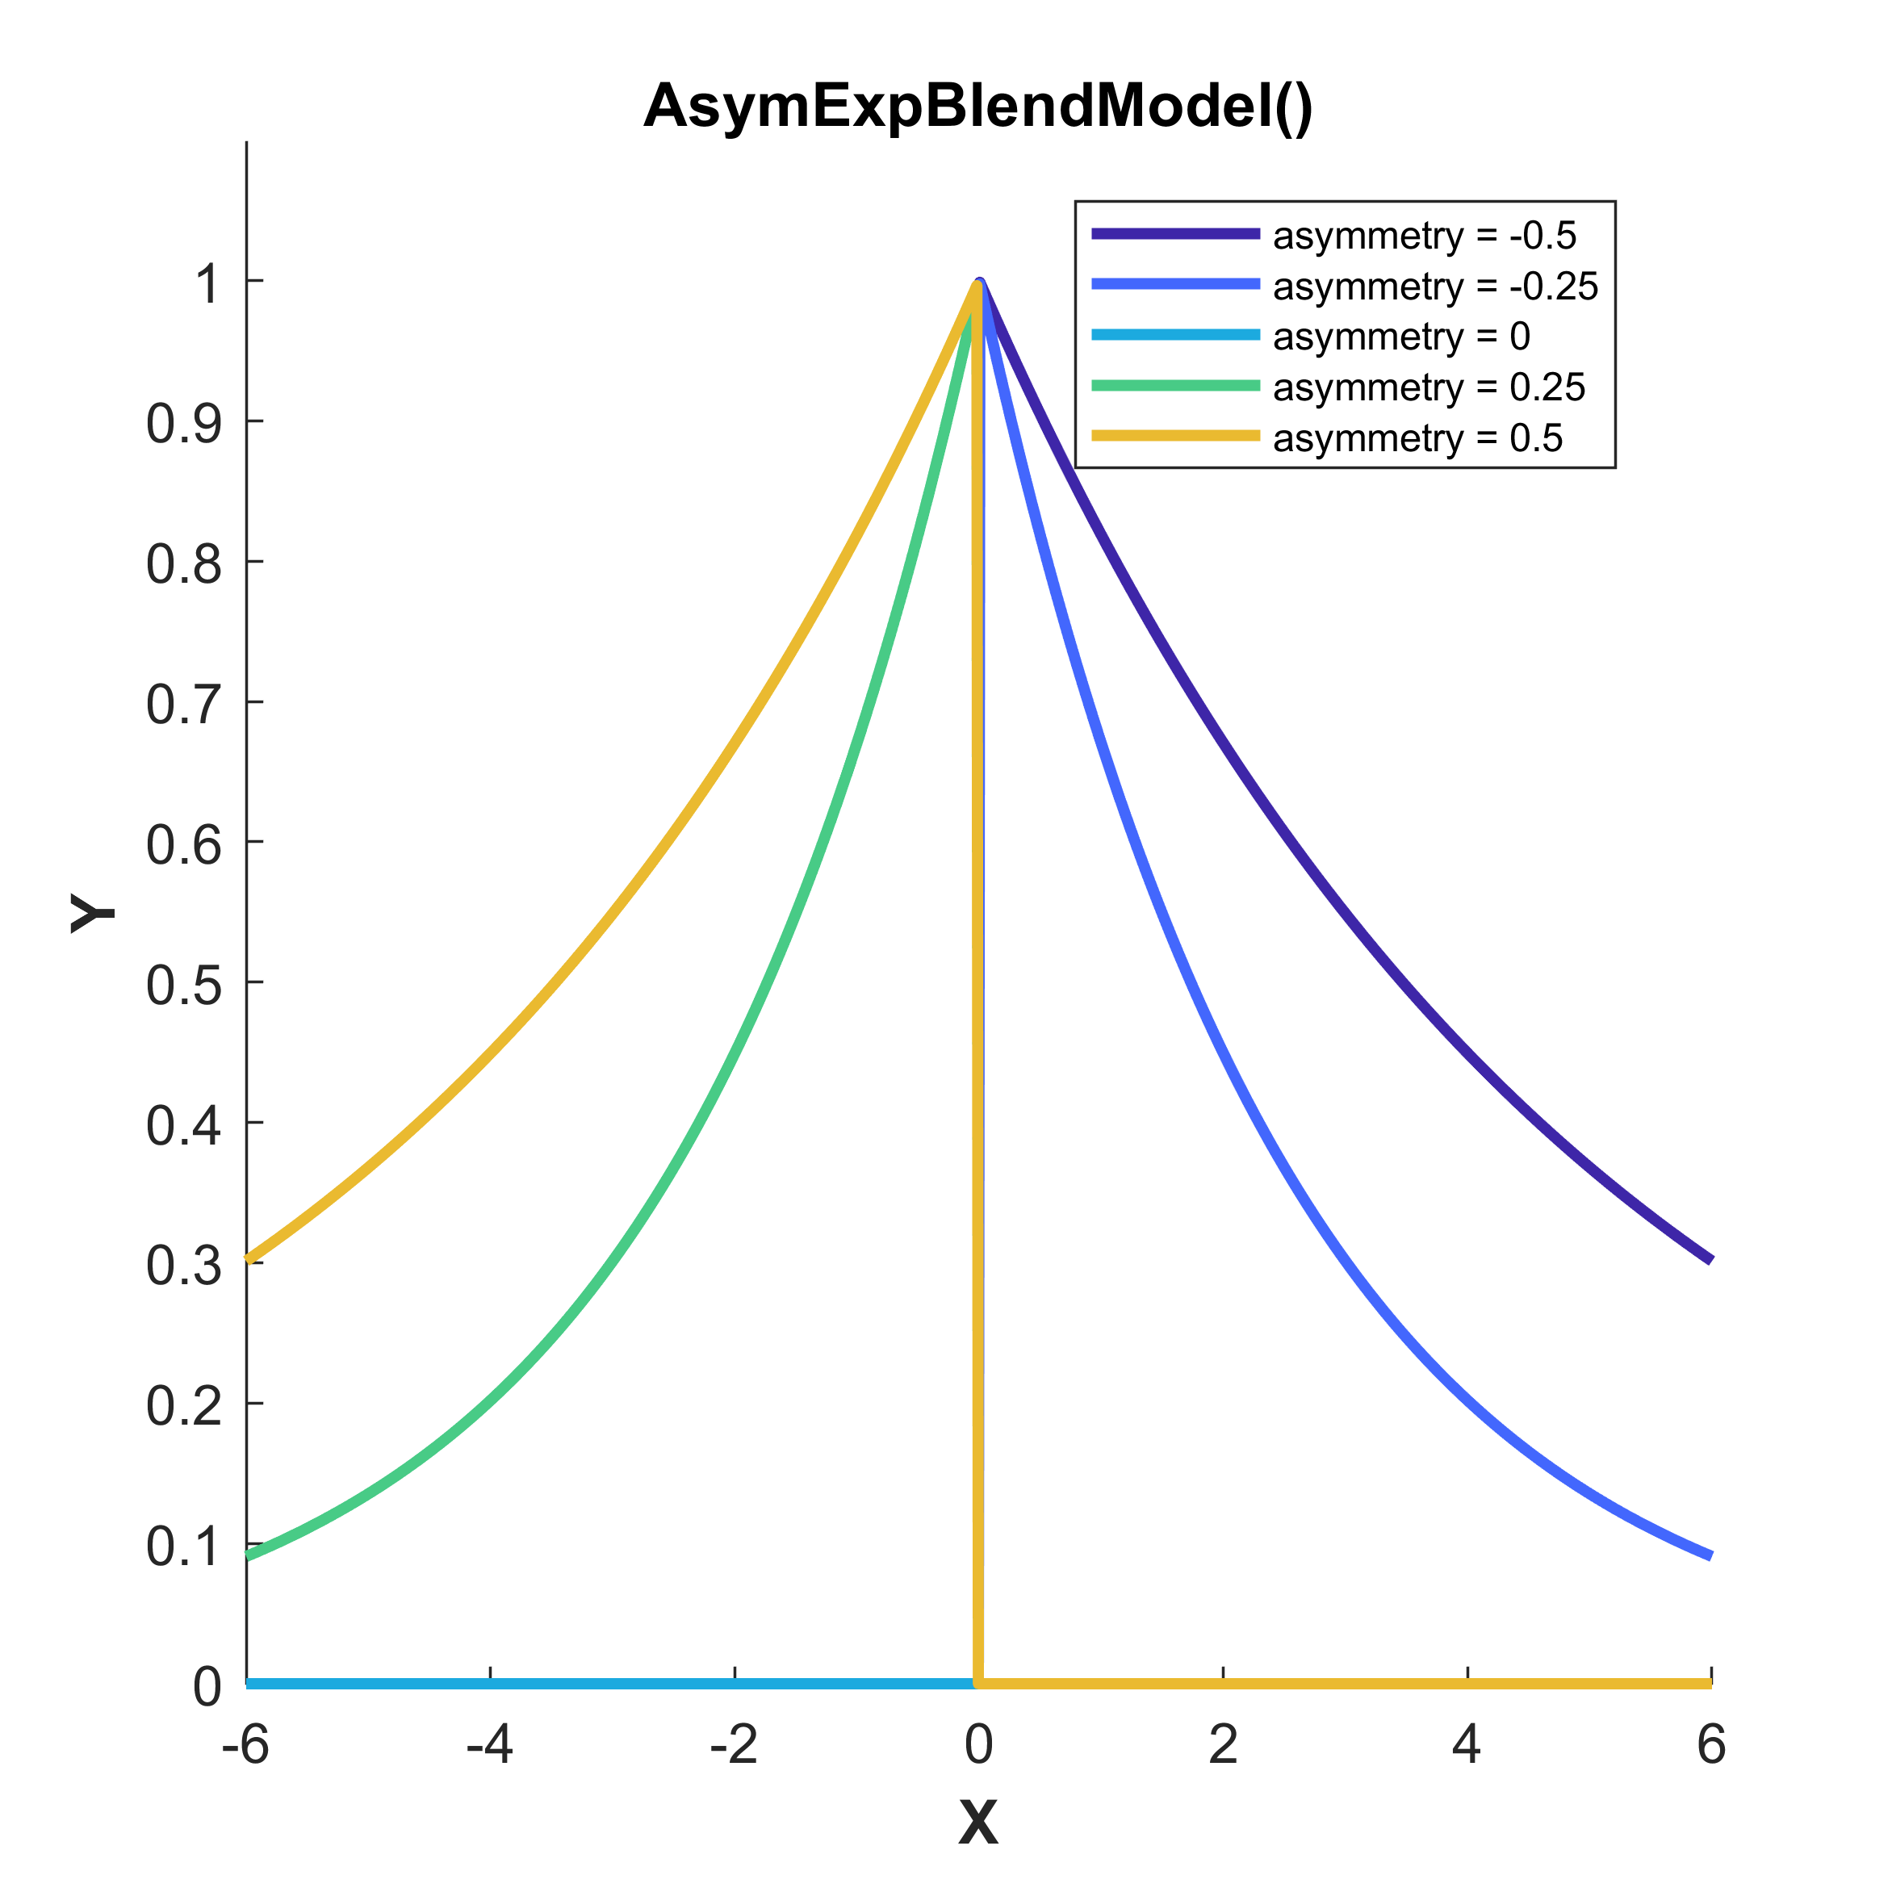
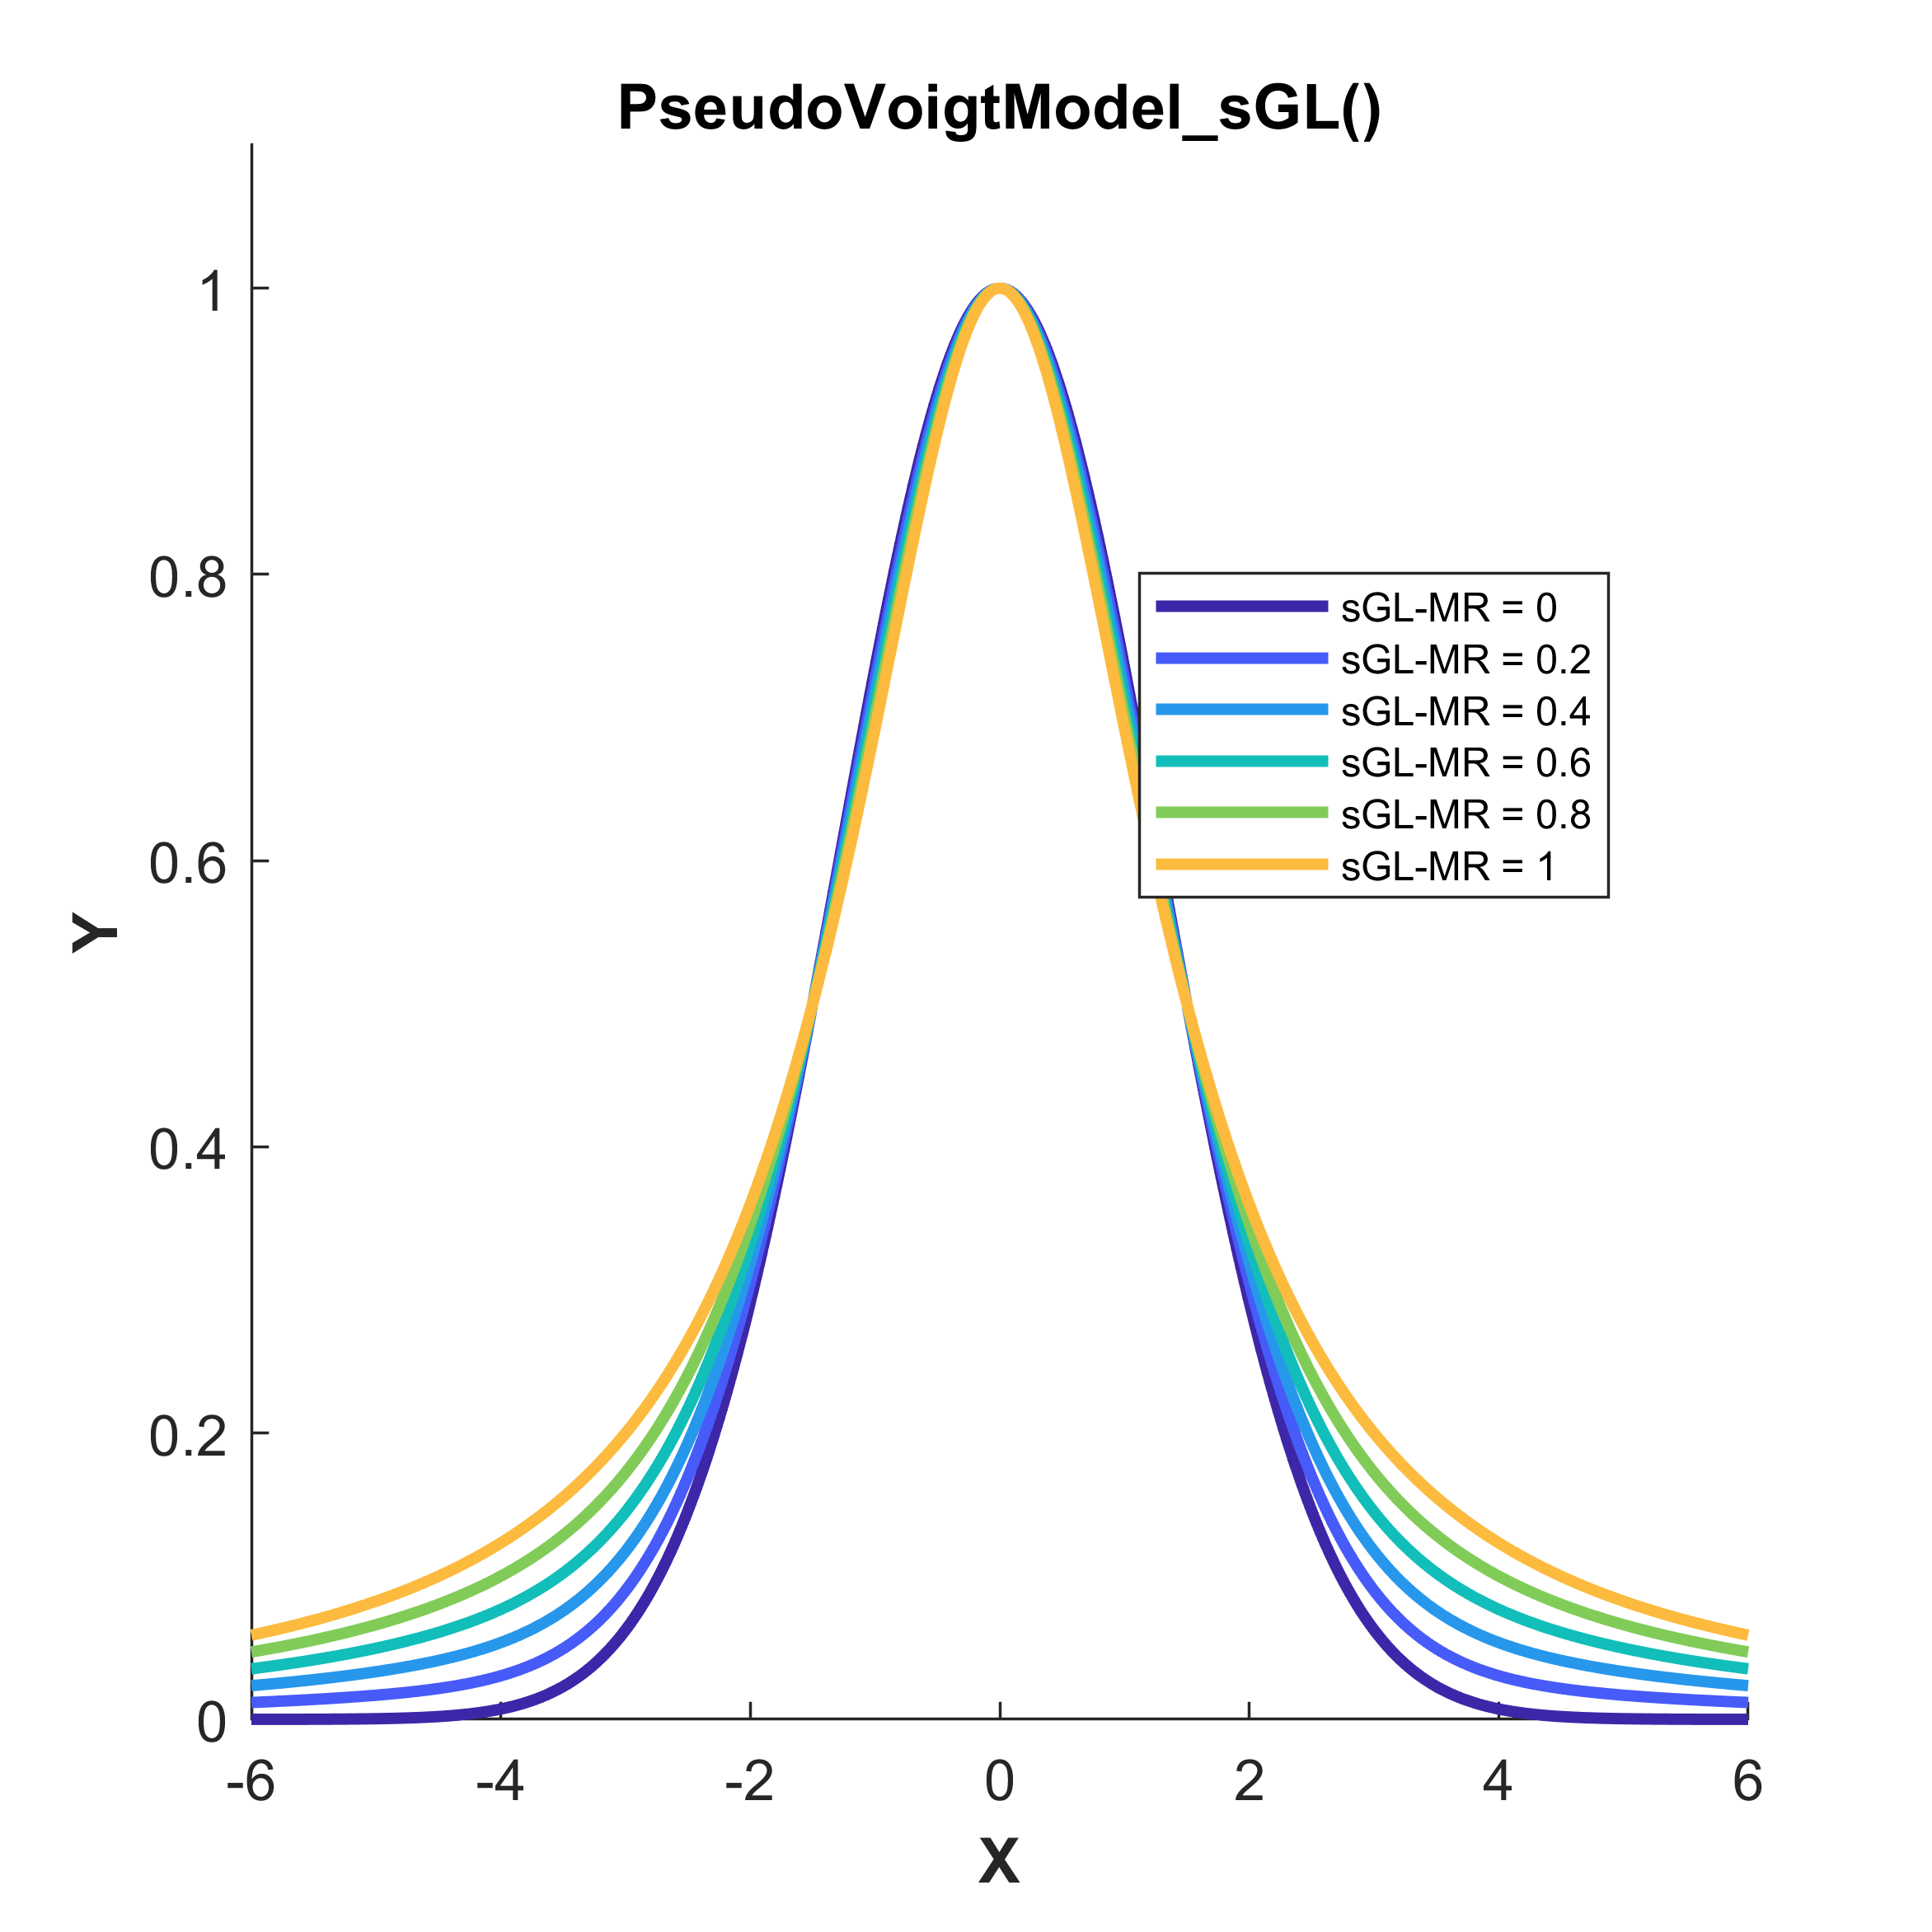
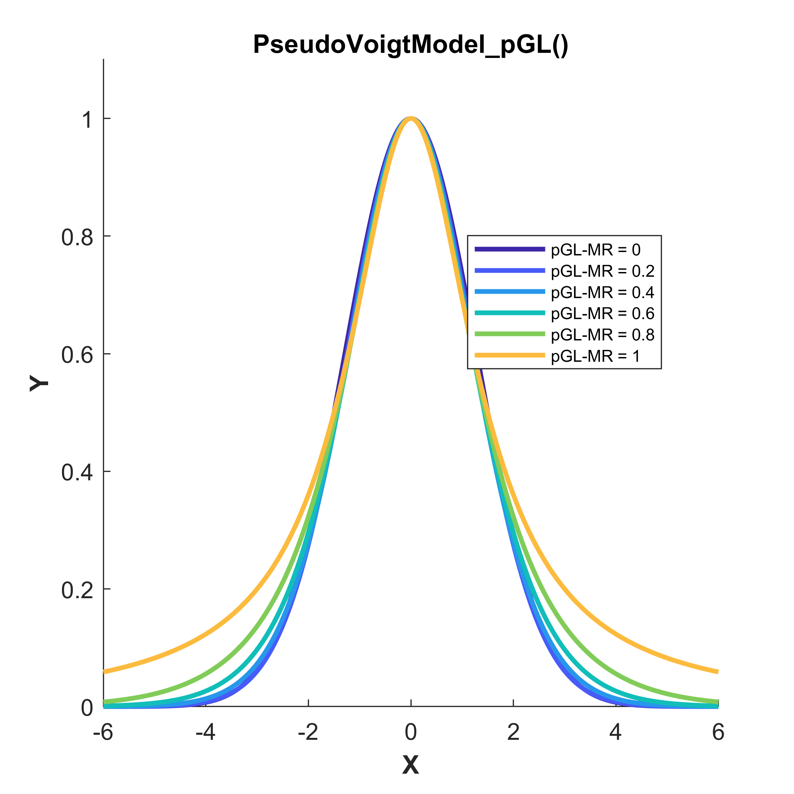
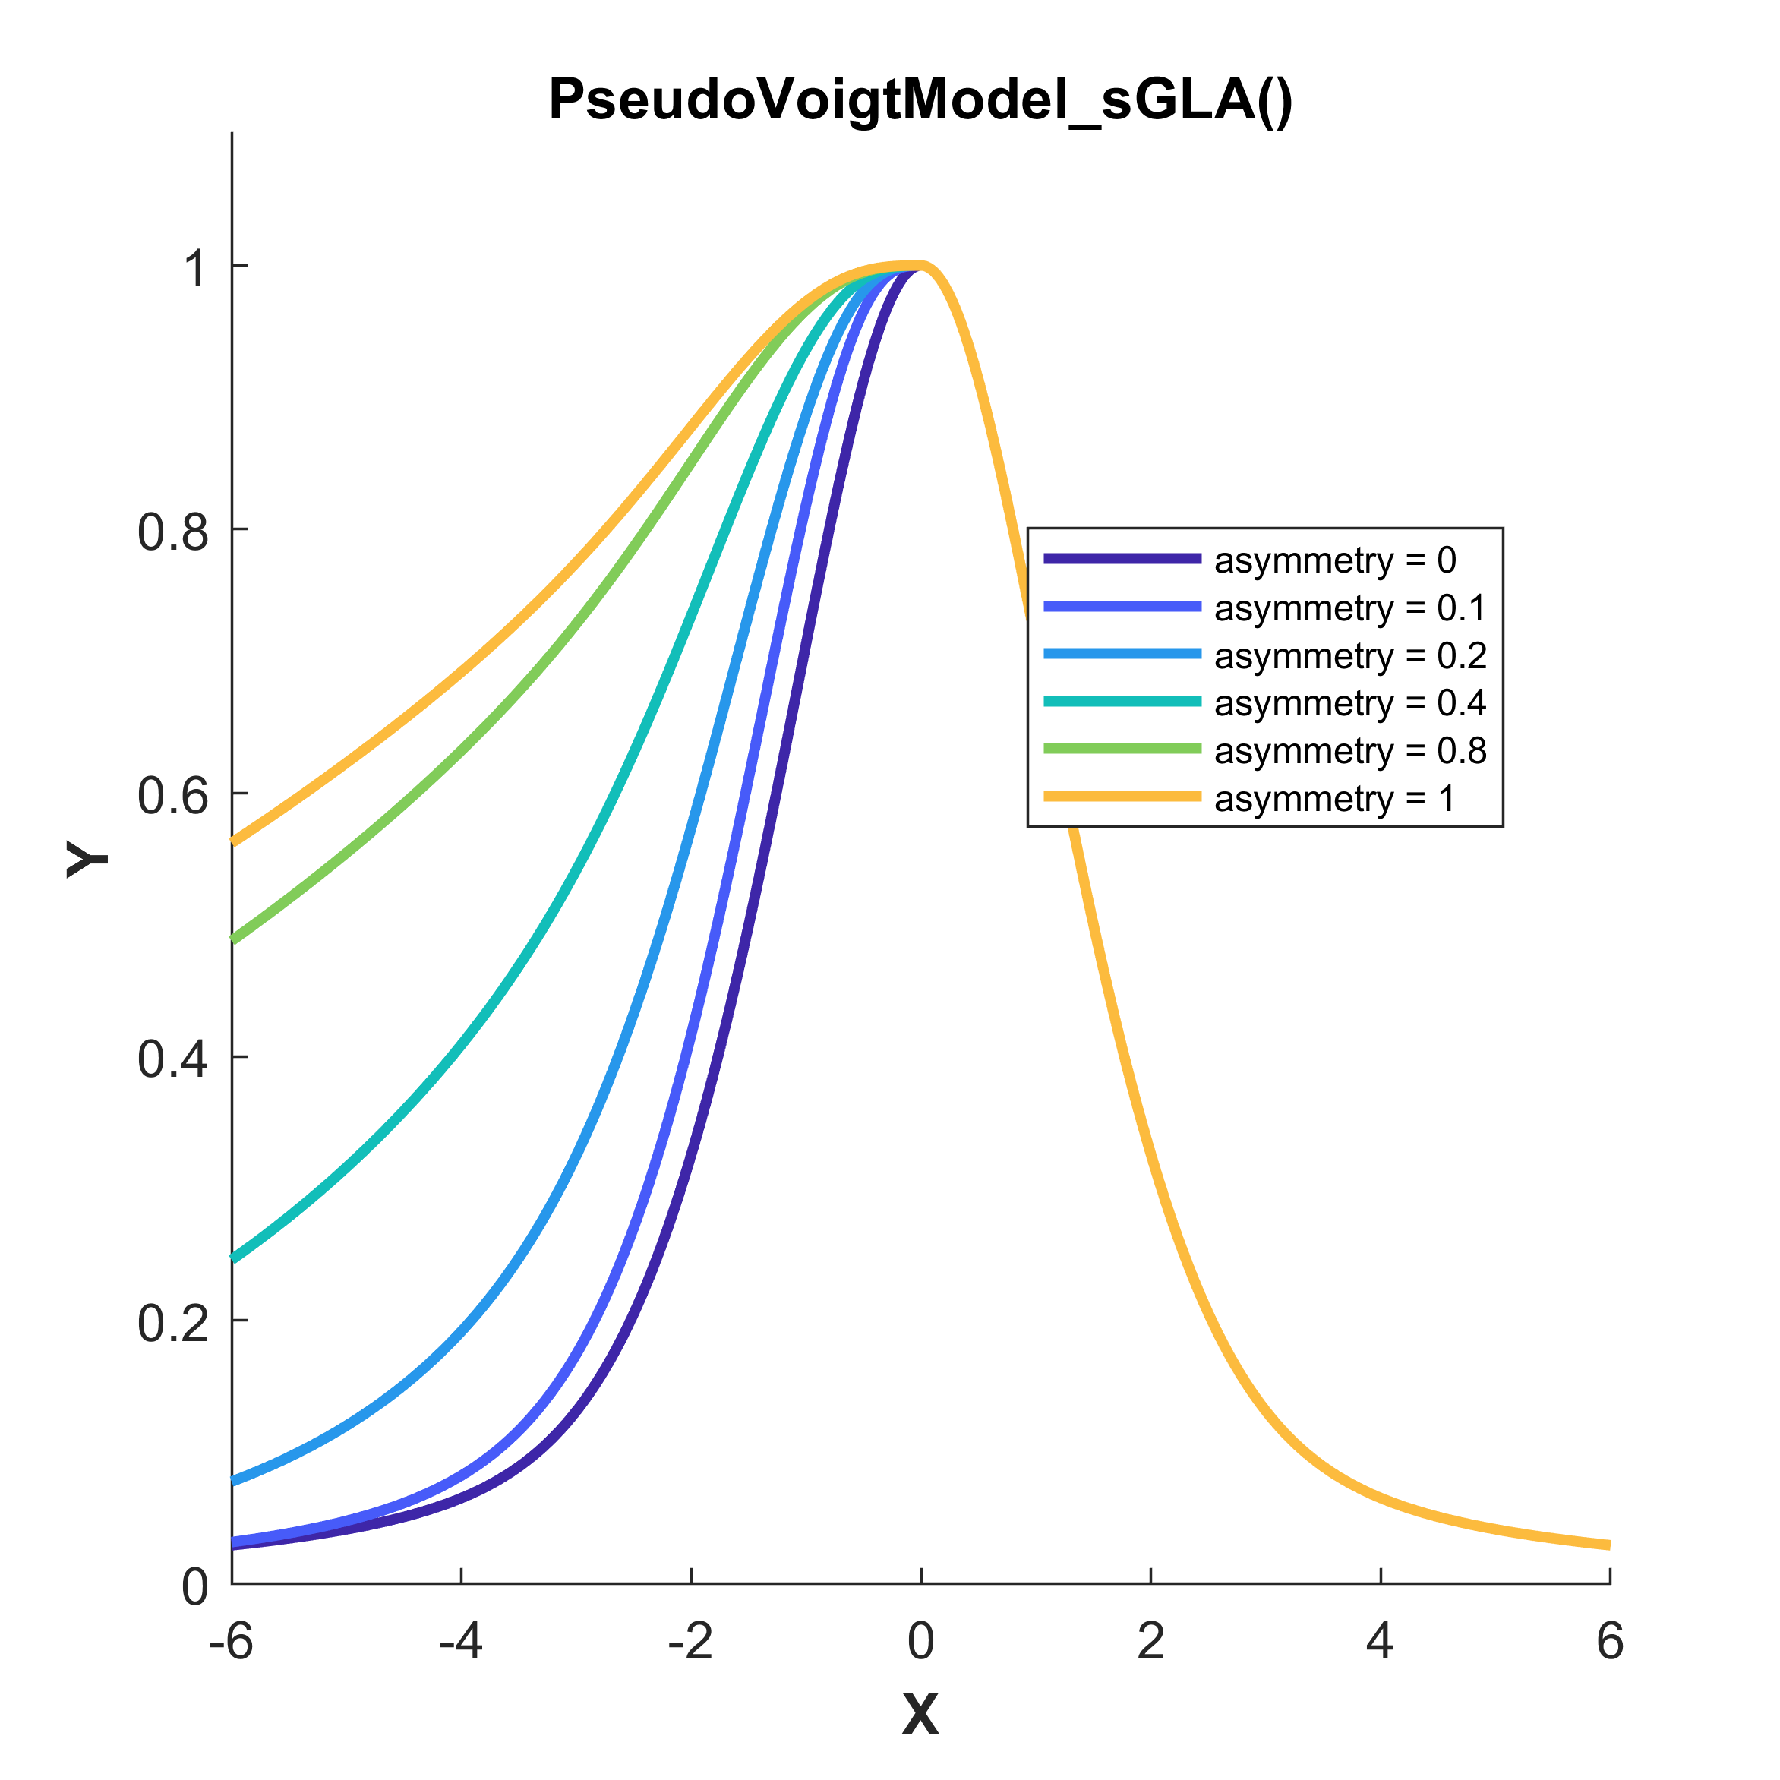
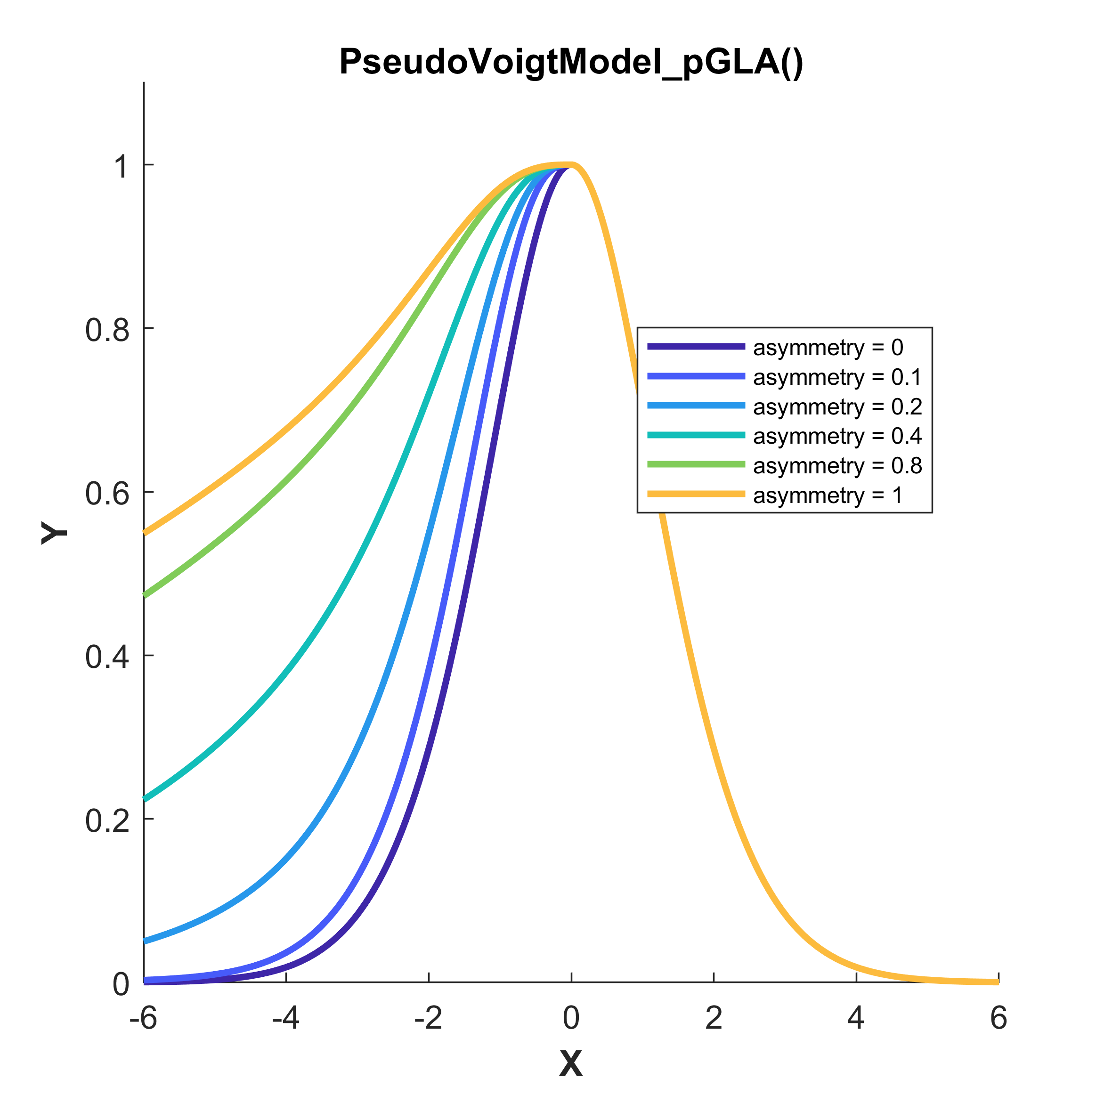
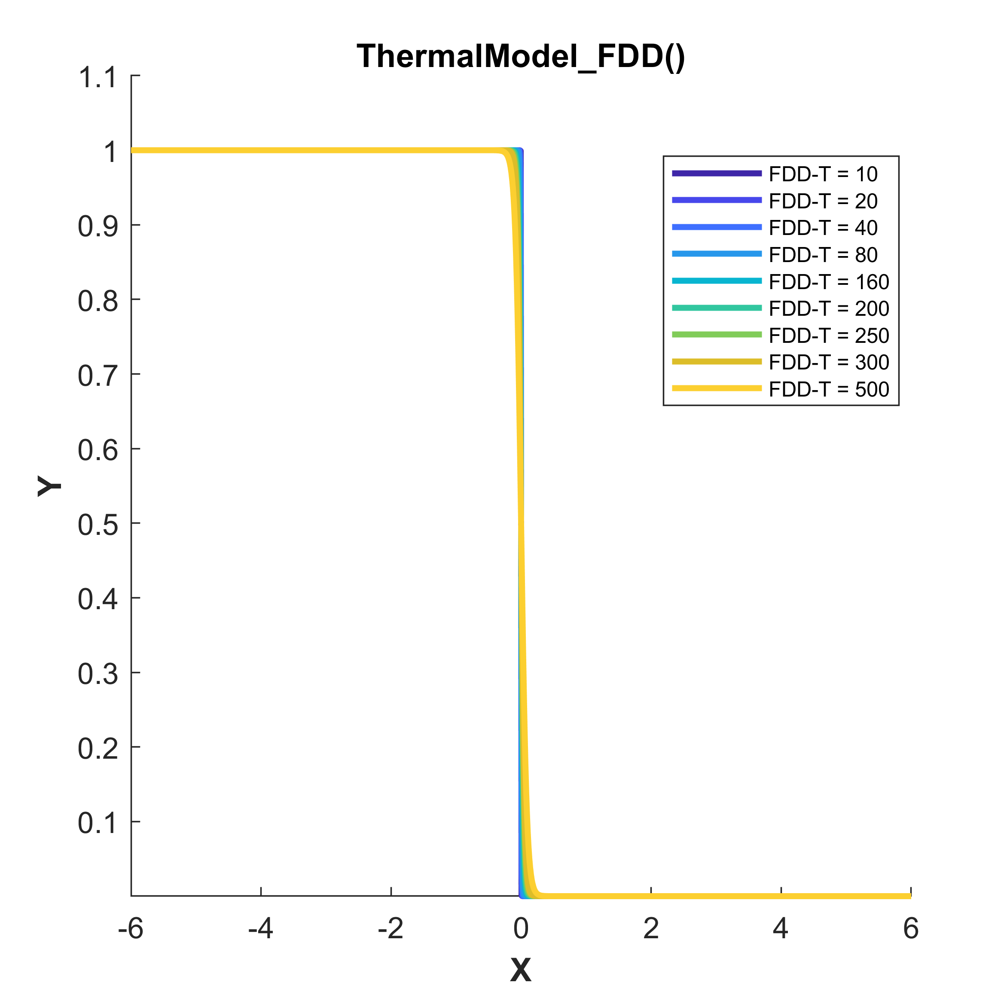
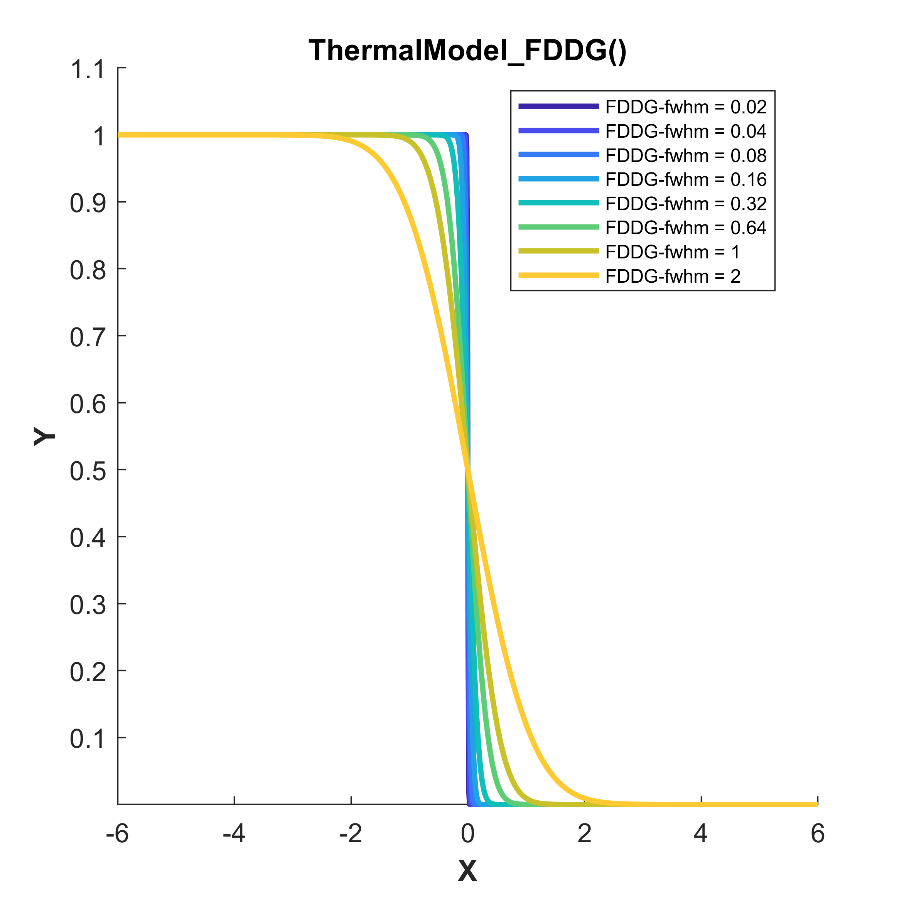
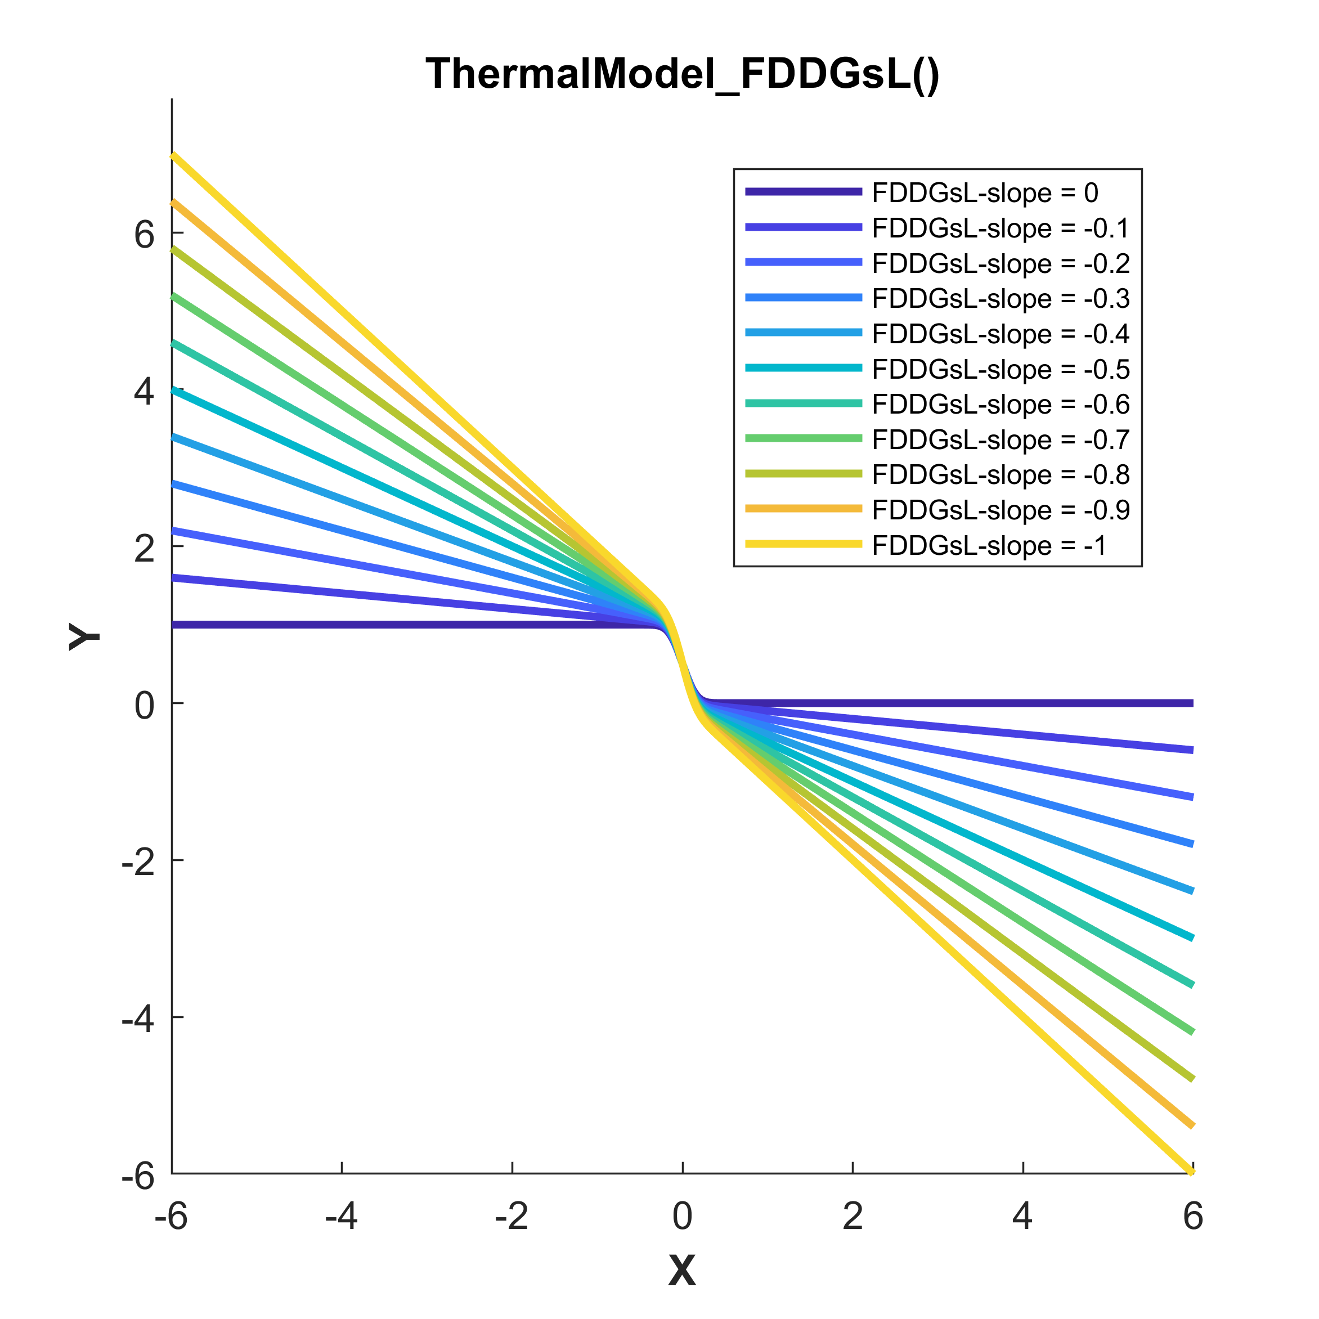
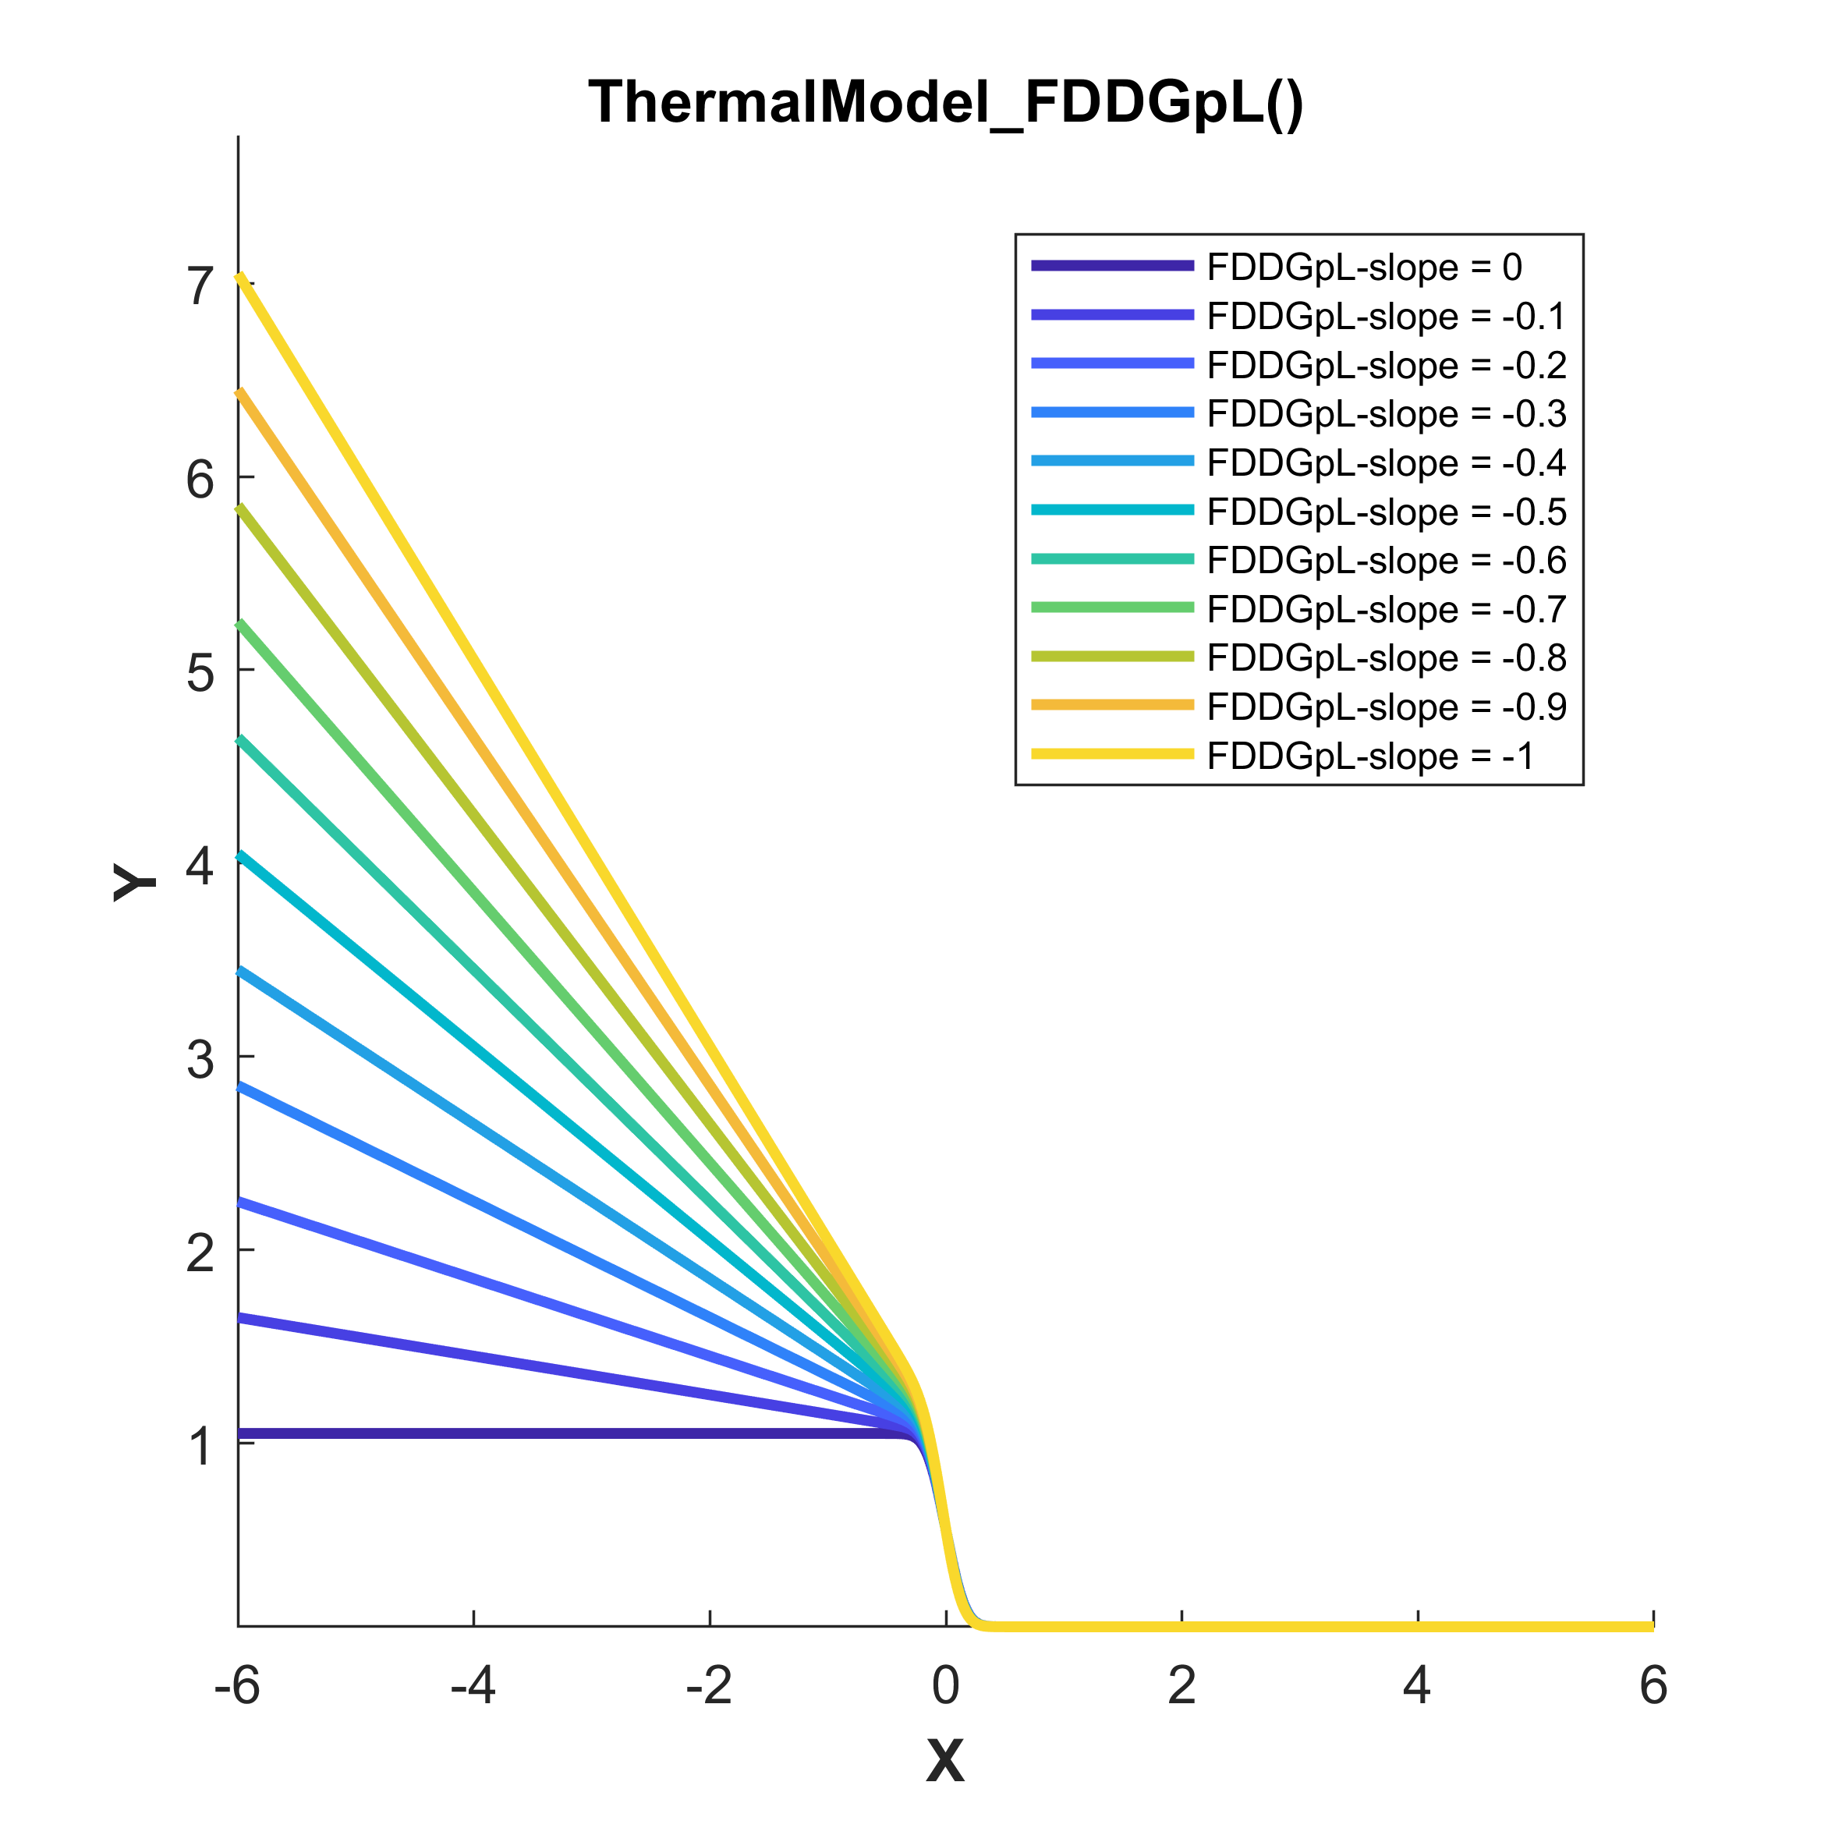
Showcase of the peak-like curve shapes

